Slide 1


Sharing Session on HKIEd
Wi-Fi Services and Useful Tips
Fred Pang
10 Dec 2013

Slide 2
Agenda
HKIEd’s Wi-Fi Deployment History
Current HKIEd’s Wi-Fi Deployment
Recent Changes
HKIEd’s SSIDs
Wi-Fi Network Topology
Wi-Fi Basic Concept
Wi-Fi Limitations

Slide 3
Agenda (cont’d)
Wi-Fi Security
Challenges
Recent Wi-Fi Usage
Wi-Fi Troubleshooting
Tips for using Wi-Fi in HKIEd
Some tools for troubleshooting
Future
Demo ( WiFi Analyzer )
Q & A

Slide 4
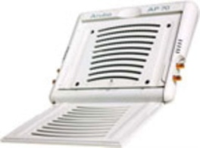
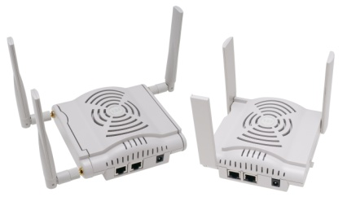
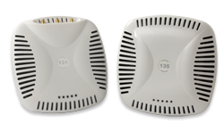
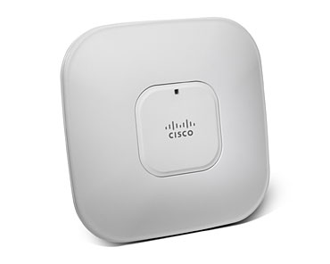
HKIEd’s Wi-Fi Deployment History
Cisco “Fat” APs in Campus ( before 2006 )
Aruba “Thin” APs in Town Center ( 2006 )
Aruba “Thin” APs in Main Campus ( 2007 )
Cisco “Thin” APs in Hostel ( 2010 )

Slide 5
HKIEd’s Wi-Fi Deployment History (I)
Cisco “Fat” APs in Campus ( before 2006 )
Supports 802.11b ( Max 11Mbps ) only
Supports OPEN or WEP only
Supports 1 SSID per AP
Hard to manage
Installed Temporarily
Installation on per-request basis
Poor roaming capabilities

Slide 6

HKIEd’s Wi-Fi Deployment History (II)
Aruba “Thin” APs in Town Center ( 2006 ) and Main Campus ( 2007 )
Supports 802.11a/b/g ( Max 54Mbps )
Supports OPEN, WEP, WPA ( TKIP ) and WPA2 ( AES )
Supports Multiple SSIDs
Centralized Management
Permanent Installation
Better roaming capabilities

Slide 7

HKIEd’s Wi-Fi Deployment History (III)
Cisco “Thin” APs in Hostel ( 2010 )
Supports 802.11a/b/g/n ( Max 300Mbps )
Supports OPEN, WEP, WPA ( TKIP ) and WPA2 ( AES )
Supports Multiple SSIDs
Centralized Management
Permanent Installation
Better roaming capabilities

Slide 8
Current HKIEd’s Wi-Fi Deployment
More than 700 APs installed to both Main Campus ( ~ 350 APs ) and Hostel ( ~ 350 APs )
Some main campus areas support 802.11a/b/g/n – Learning commons, Canteen, All Library area
Some main campus and Hostel areas support “Spectrum analysis” – not only monitor Wi-Fi signal

Slide 9
Recent Changes (I)
Upgraded our Aruba controllers for Main Campus to support 802.11n APs
Provided a dedicated 300Mbps ( Local ) + 160Mbps ( International ) Link ( via Wharf T&T ) for hostel wired and wireless users
Reduced no. of SSIDs in Main Campus and Hostel
Changed hostel’s SSIDs to “Hostel” and “HostelGuests”

Slide 10
Recent Changes (II)
Fine-tune transmission power ( Tx ) to reduce co-channel interference
Increased “Arp cache” to support more users in firewall
Removed lower data rate support ( 1Mbps, 2Mbps and 5.5Mbps )
Enabled “Band Steering/Select” to help wireless clients to use 802.11a/an ( 5GHz )

Slide 11
Recent Changes (III)
Removed “Rogue” APs in some areas such as Pacific Coffee, MIT which might interfere with our signal
Installed airwave to locate “Rogue” APs and for clients troubleshooting
Self-developed monitoring tool for WiFi troubleshooting
Upgrade ALL APs in Library area to support both 802.11AN & 802.11GN
Removed support of 802.11b clients
Deployed 5 APs in C-LP-11 to support 600 people to access internet for teaching purpose simultaneously

Slide 12
HKIEd’s SSIDs
SSID | Location | Encryption | Authentication
HKIEd | All Main Campus Area | WPA(TKIP)/WPA2(AES) | 802.1x
HKIEdGuests/VPN | All Main Campus Area | OPEN | Captive Portal
eduroam | All Main Campus Area | WPA(TKIP) | 802.1x
Universities WiFi | Only G/F Main Campus Area | WPA(TKIP)/WPA2(AES) | 802.1x
PCCW | Only G/F Main Campus Area | OPEN | Captive Portal
PCCW1x | Only G/F Main Campus Area | WPA(TKIP)/WPA2(AES) | 802.1x
Y5ZONE | Only G/F Main Campus Area | OPEN | Captive Portal
Hostel | All Hostel Area | WPA(TKIP)/WPA2(AES) | 802.1x
HostelGuests | All Hostel Area | OPEN | Captive Portal
Quarter | All Hostel Area | WPA(TKIP)/WPA2(AES) | 802.1x

Slide 13






Wi-Fi Network Topology (Main Campus)
HARNET
Secondary Link
h-r2a
Wireless
Controllers
( Aruba )
Traffic Mgmt/
IPS/
firewall
Border
Routers
HARNET
Primary Link
h-r3
Access Point
Core
Network
2.4/5GHz
Clients

Slide 14
Wi-Fi Network Topology (Hostel)
Wharf T&T
300Mb (Local)
160Mb ( International )
Link
h-r2a
Wireless
Controllers
( Cisco )
Traffic Mgmt/
IPS/
firewall
Border
Routers
h-r3
Access Point
Core
Network
2.4/5GHz
Clients

Slide 15

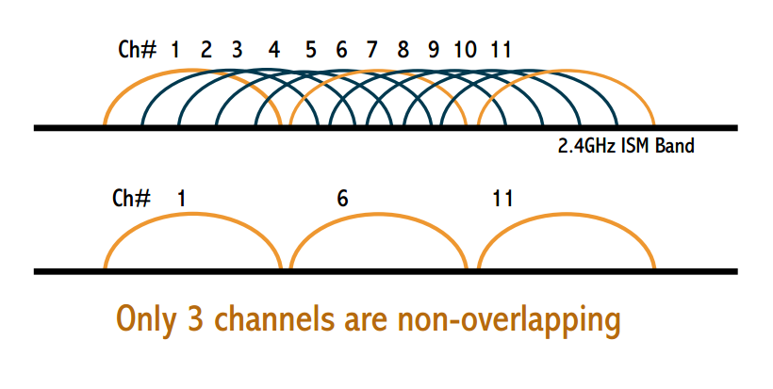
Wi-Fi Basic Concept (I)
Channel 2.4GHz band (only 3 channels have non-overlapping frequency )

Slide 16
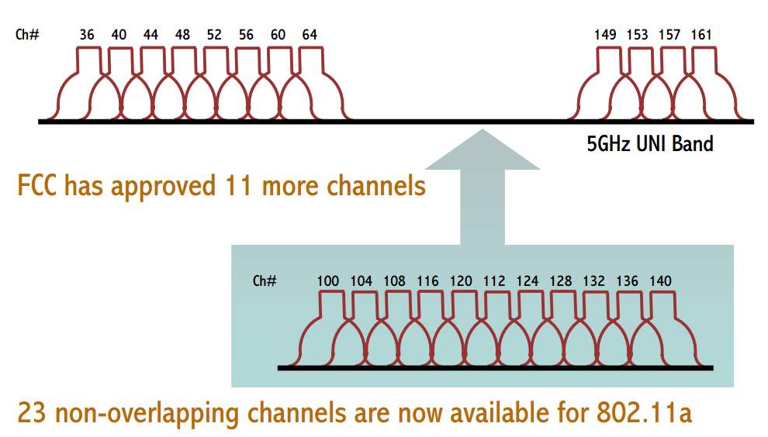
Wi-Fi Basic Concept (II)
Channel 5GHz band ( 23 channels have non-overlapping frequency )

Slide 17
Wi-Fi Limitation (I)
Some points you might need to know:-
“DATA RATES” quoted in the Wi-Fi specifications refer to the raw radio symbol rate, NOT the actual TCP/IP throughput rate. The rest is called protocol overhead.
A good rule of thumb: the practical TCP/IP throughput is about HALF the data rate. For example, a 54 Mbps 802.11a link has a maximum practical throughput of roughly 25 Mbps.

Slide 18
Wi-Fi Limitation (II)
Type of Interferences
Co-Channel Interference (CCI)
Adjacent Channel Interference (ACI)

Slide 19
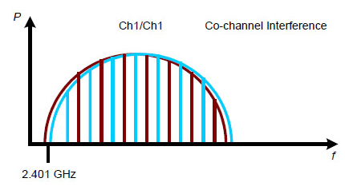
Wi-Fi Limitation (III)
Co-Channel Interference (CCI)

Slide 20
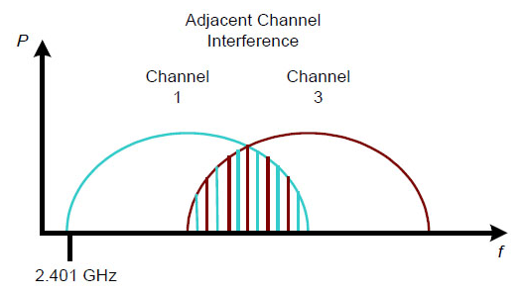
Wi-Fi Limitation (IV)
Adjacent Channel Interference (ACI)

Slide 21
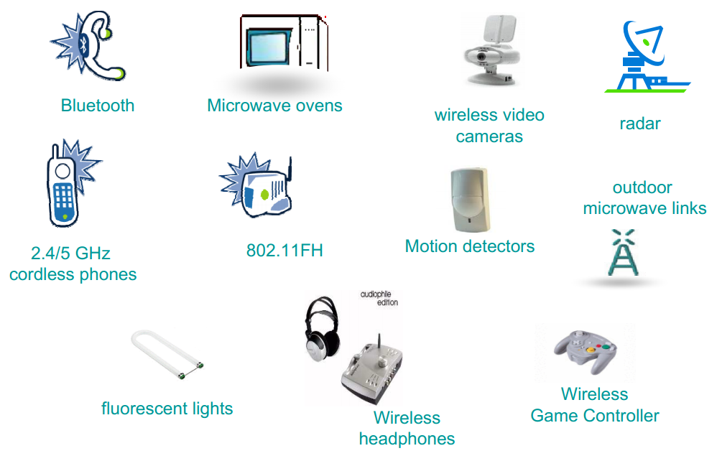
Wi-Fi Limitation (V)
Non-Wi-Fi Interference Sources

Slide 22
Wi-Fi Security (I)
Implement the following safeguards
Ensure your operating system is fully patched
Verify antivirus software has latest virus definition updates
Update 3rd party software ( like Adobe reader and MS Office )

Slide 23
Wi-Fi Security (II)
Avoid to connect “OPEN” ssid in public area
Avoid to connect “UNKNOWN” ssid
Select better wireless network that use some form of encryption ( WPA2/ WPA/ WEP )
HTTPS/SSL
Avoid to perform any kind of banking activity/ financial transaction while connected to a PUBLIC hot spot

Slide 24
Challenges (I)
Upgrading every Wi-Fi access point to support 802.11n in the 2.4 and 5 GHz band in main campus
Continuing to expand the number of access points in high user areas to help alleviate wireless congestion
Deploying access points that are capable of detecting interference from outside sources

Slide 25
Challenges (II)
continuing to work with our wireless vendor (Aruba and Cisco) to improve our wireless services
maintaining a close relationship with our Departments in order to continue to improve wireless service to staff and students
performing thorough Wi-Fi capacity and coverage assessment surveys periodically to ensure the appropriate deployment of wireless access points

Slide 26
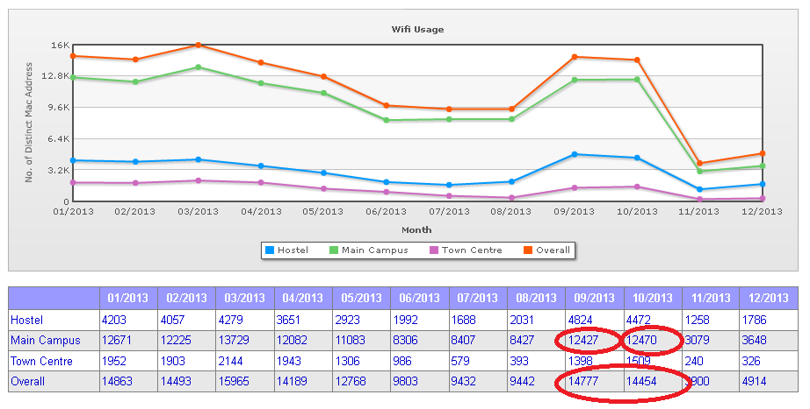
Recent Wi-Fi Usage

Slide 27
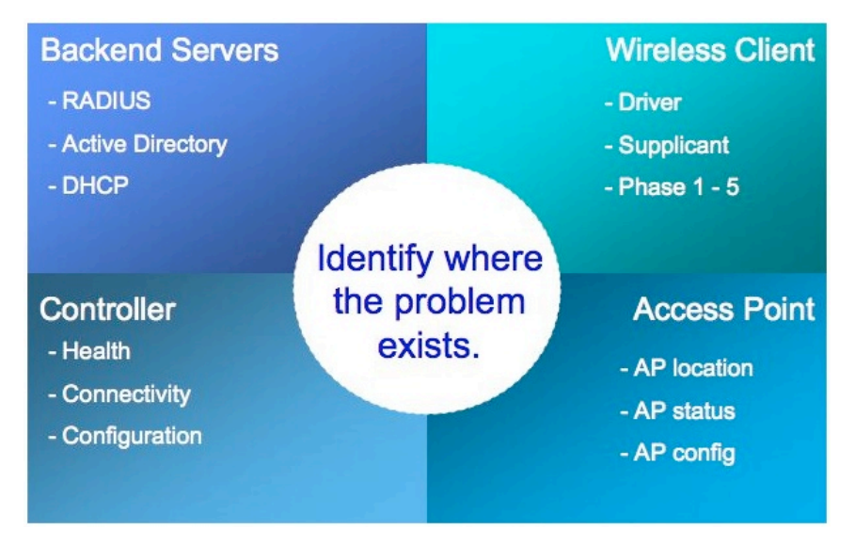
Wi-Fi Troubleshooting (I)

Slide 28
Wi-Fi Troubleshooting (II)
User Issues
Can’ t see SSID
Can’ t associate
Can’ t authenticate
Limited internet access
Poor performance
Dropped connections

Slide 29
Wi-Fi Troubleshooting (III)
Can’ t see SSID
Outside the coverage of an AP?
AP down?
Connected to LAN?
Manual disable wireless interface?
Driver issue?

Slide 30
Wi-Fi Troubleshooting (IV)
Can’ t associate
Wrong setting? ( OPEN, WEP, WPA, WPA2 )
Rogue AP?

Slide 31
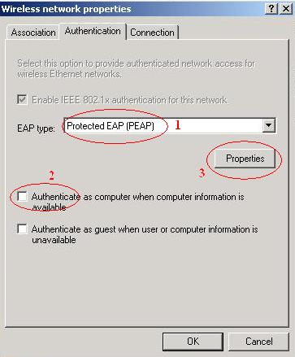
Wi-Fi Troubleshooting (V)
Can’ t authenticate
Wrong user name?
Wrong Authentication Method?
Wrong password?
Changed password?

Slide 32
Wi-Fi Troubleshooting (VI)
Limited internet access
Hardcoded IP address?
IP used up?
DHCP server down?

Slide 33
Wi-Fi Troubleshooting (VII)
Poor performance
Interference?
Too many users?

Slide 34
Wi-Fi Troubleshooting (VIII)
Dropped connections
OS/Firmware/Driver not update?

Slide 35
Some tools for troubleshooting (I)
Wi-Fi Analyzer ( Android )
inSSIDer ( WinXP/Vista/Win7/Win8 )
speedtest.ofca.gov.hk
ping ( Notebook/Netbook/Desktop )

Slide 36
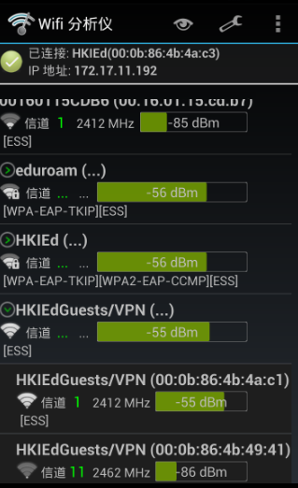
Some tools for troubleshooting (II)
WiFi Analyzer ( Android )

Slide 37
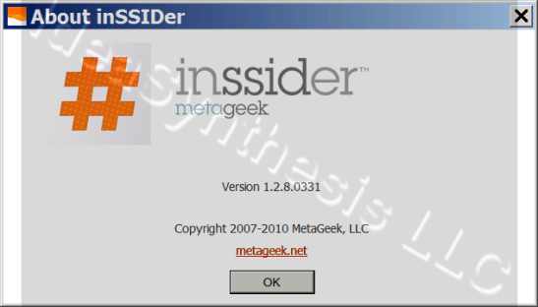
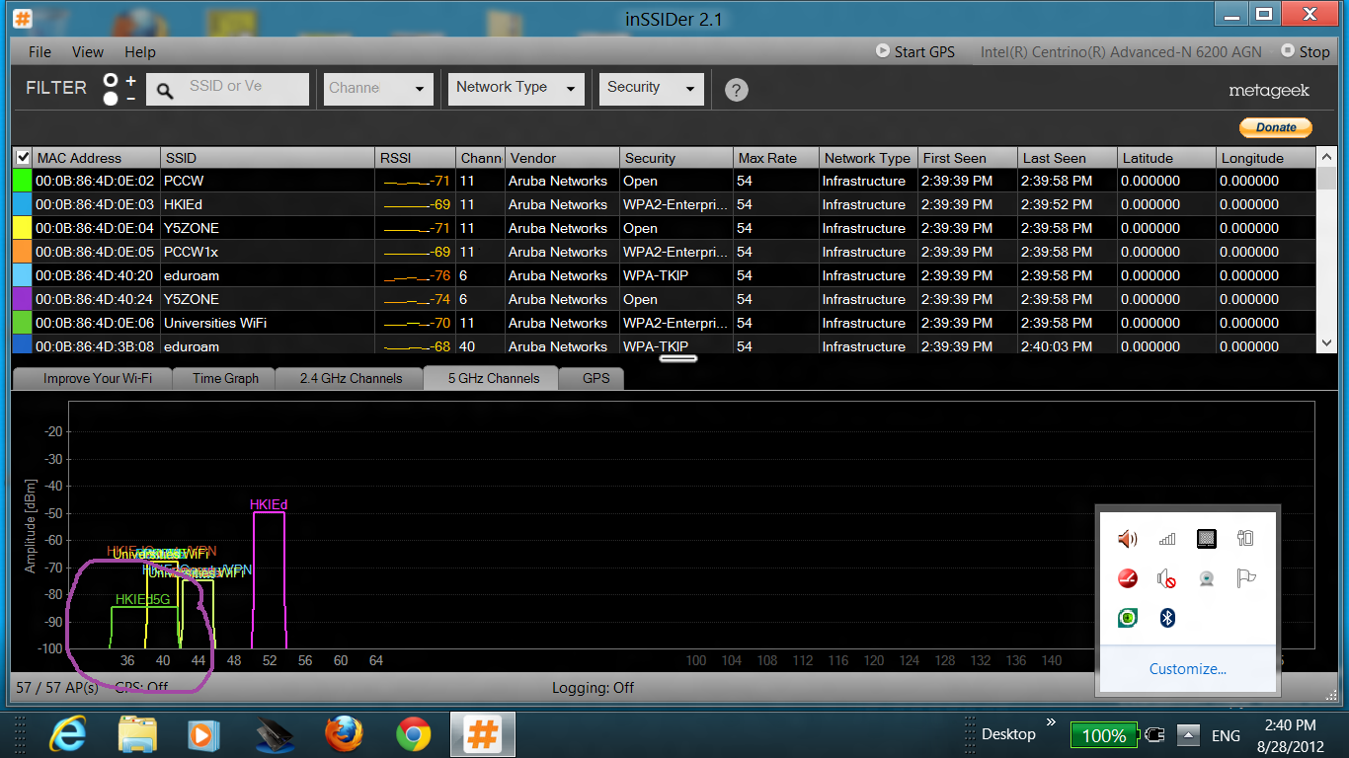
Some tools for troubleshooting (III)
inSSIDer ( WinXP/Vista/Win7/Win8 )

Slide 38
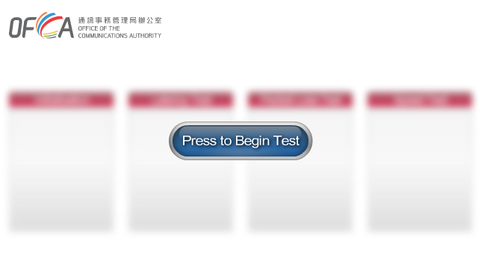
Some tools for troubleshooting (IV)
speedtest.ofca.gov.hk

Slide 39
Some tools for troubleshooting (V)
“Ping”
C:\>ping www.google.com.hk
Pinging www.google.com.hk [74.125.128.106] with 32 bytes of data:
Reply from 74.125.128.106: bytes=32 time=405ms TTL=50
Reply from 74.125.128.106: bytes=32 time=412ms TTL=50
Reply from 74.125.128.106: bytes=32 time=401ms TTL=50
Reply from 74.125.128.106: bytes=32 time=409ms TTL=50
Ping statistics for 74.125.128.106:
Packets: Sent = 4, Received = 4, Lost = 0 (0% loss),
Approximate round trip times in milli-seconds:
Minimum = 401ms, Maximum = 412ms, Average = 406ms
C:\>

Slide 40
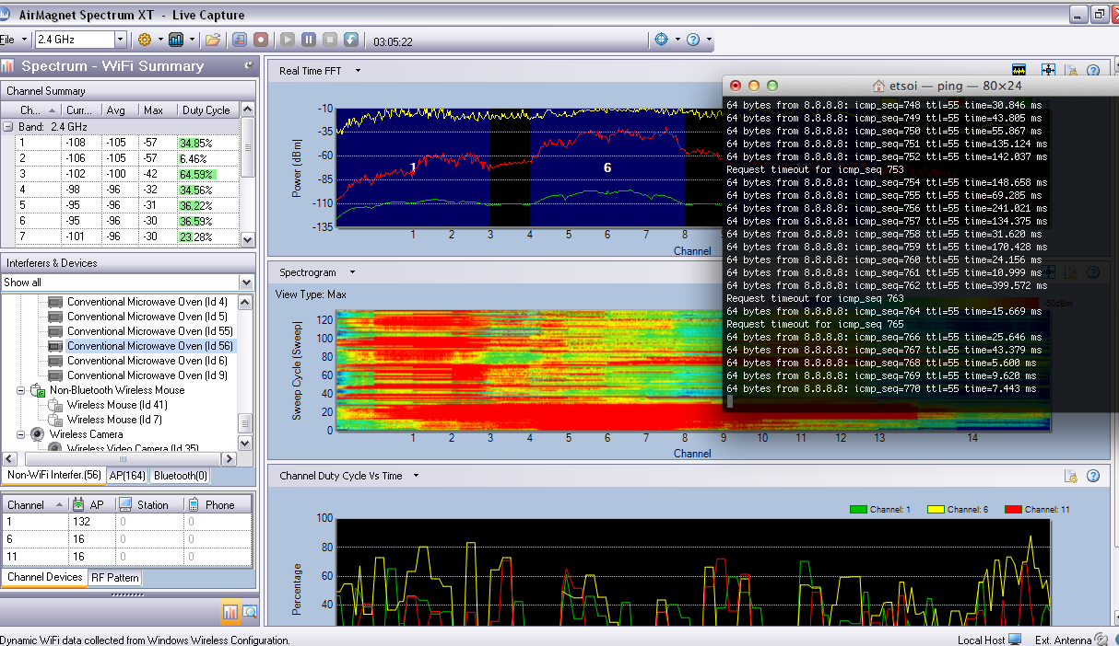
Some tools for troubleshooting (VI)

Slide 41
Tips for using Wi-Fi in HKIEd (I)
Do not predicate time sensitive activities on use of Wi-Fi
Turn off unnecessary clients
Encourage the use of 802.11n (5 GHz) clients
Encourage to update wireless drivers or OS patches
Encourage to use ssid “HKIEd” , “Hostel” and “Quarter” for better security protection

Slide 42
Tips for using Wi-Fi in HKIEd (II)
Be considerate! Not to set up Rogue AP or tethering in campus or hostel area

Slide 43

Future (I)
802.11ac
Fifth generation Wi-Fi
Uses 5Ghz frequency band only
3x times faster
Better video and online gaming experience
Supports multi-user MIMO

Slide 44
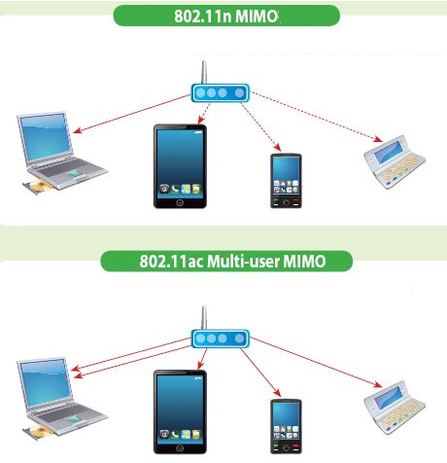
Future (II)

Slide 45
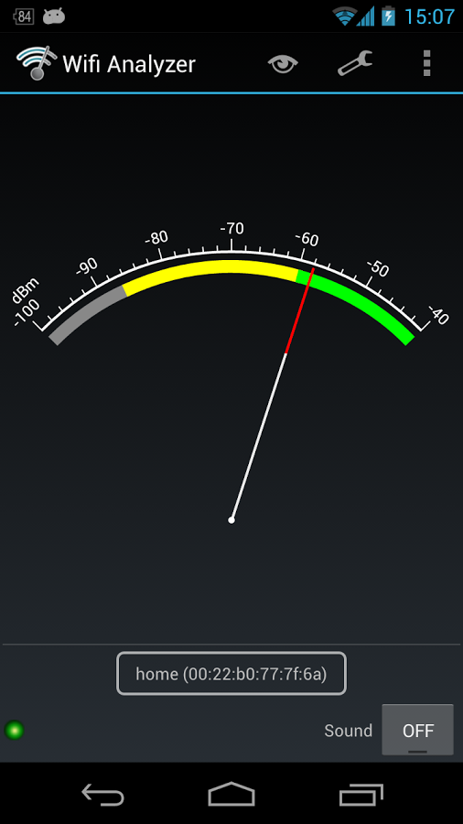
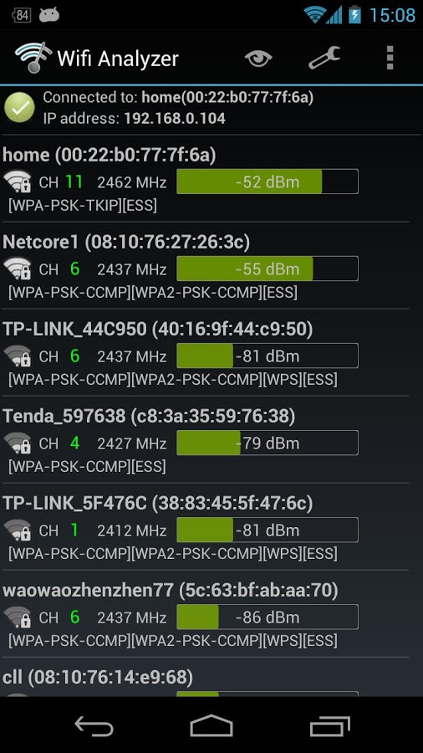
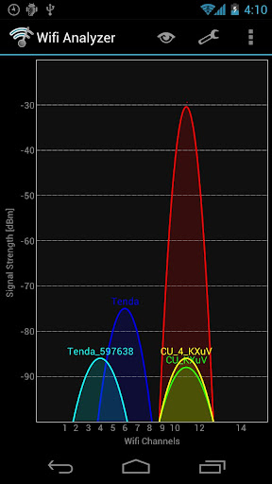
Demo
( using Android WiFi Analyzer )

Slide 46
Q & A

Slide 47
Wi-Fi still doesn't work?
Get walk-in help at IT Help Desk ( Office Hour )
Contact IT Help Desk at 2948 6601 ( Office Hour )
Email us at helpdesk@ocio.ied.edu.hk
http://its.web.ied.edu.hk/network/wireless.htm
http://its.web.ied.edu.hk/wifi101/

Slide 48
Thank You
Fred Pang
Computer Officer
tcpang@ied.edu.hk

