Slide 1

Reviewing Multilingual Education in Nepal
International Symposium on Multilingualism and Multilingual Education in China (28-30 November 2014)
Pushker Kadel
Director, Language Development Centre Nepal
Email: pushker.kadel@gmail.com
Website: www.ldcnepal.org

Slide 2
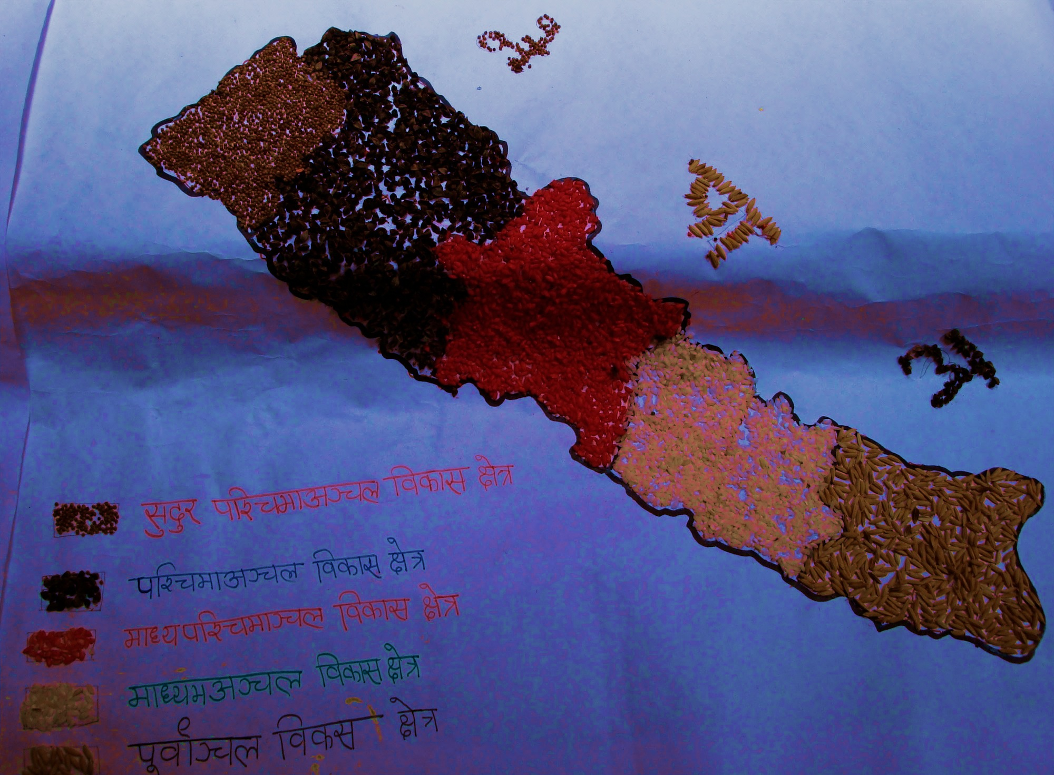
Language situation
Population: 26.495 Million
126 ethnic communities
123 languages
55.36% do not speak Nepali as their mother tongue

Slide 3
Language in Education Policies
All Nepalese have right to basic education in their own mother tongue (Section 3, Interim Constitution of Nepal, 2007)
Each Nepali Community has right to preserve and promote its language, script (Section 3, Interim Constitution of Nepal, 2007)
Local language (mother tongue) will be taught as a subject (National Curriculum Framework for School Education (pre-school – grade 12), CDC)
Primary education should be in mother tongue (Education Act 1971, revision 2007, Section 7.2 (b)
Mother tongue will be the medium of instruction in basic education especially Grade 1-3 (National Curriculum Structure 2007)

Slide 4
Language in Education Policies Cont.
MLE will be implemented in 7500 schools by 2015 (School Sector Reform Plan 2009-2015
Mother Tongue will be taught as a subject, Basic Education Curriculum, Grade 6-8 (Basic Education Curriculum 6-8 Grades, 2012, CDC-Nepal)
The medium of instruction for all students, except Nepali and English languages, shall be local mother tongues in basic education up to grade three (MLE implementation Guidelines, 2010)
Multilingual Education will be promoted (Three years Interim Plan 2007-2010)

Slide 5
Nepal’s International Agreements
Dakar framework for action by 2015 all children, particularly girls and children from ethnic minorities have access to complete free and compulsory primary education of good quality
Millennium Development Goal 2
achieving universal primary education for every child by 2015
Education For All Goals: including
Access for all children, Meeting learning needs of all children
ILO 169: Relate to the rights of indigenous communities in Nepal
Declaration of the Rights of Indigenous People: Relates to rights of indigenous peoples: their culture, identity, language, employment, health, education and other issues.

Slide 6
Positive Developments in MLE
Nepal MLE Symposium 2007
MT as a subject
  15 Languages: Textbooks Grade 1-5
  1 Languages: Textbooks Grade 1-4
  3 Languages: Textbooks Grade 1-3
  1 Language: Textbook Grade 1
Reference materials/ stories / culture 15 Languages
Transitional Language Support Program is run in 19,999 classrooms using 33 local languages (Flash Report 2011/12)
6,598 schools are using MT as additional MoI in 70 districts with 732,962 students and more than 11,000 teachers are trained to teach MT. (DoE unpublished data 2013/14)

Slide 7
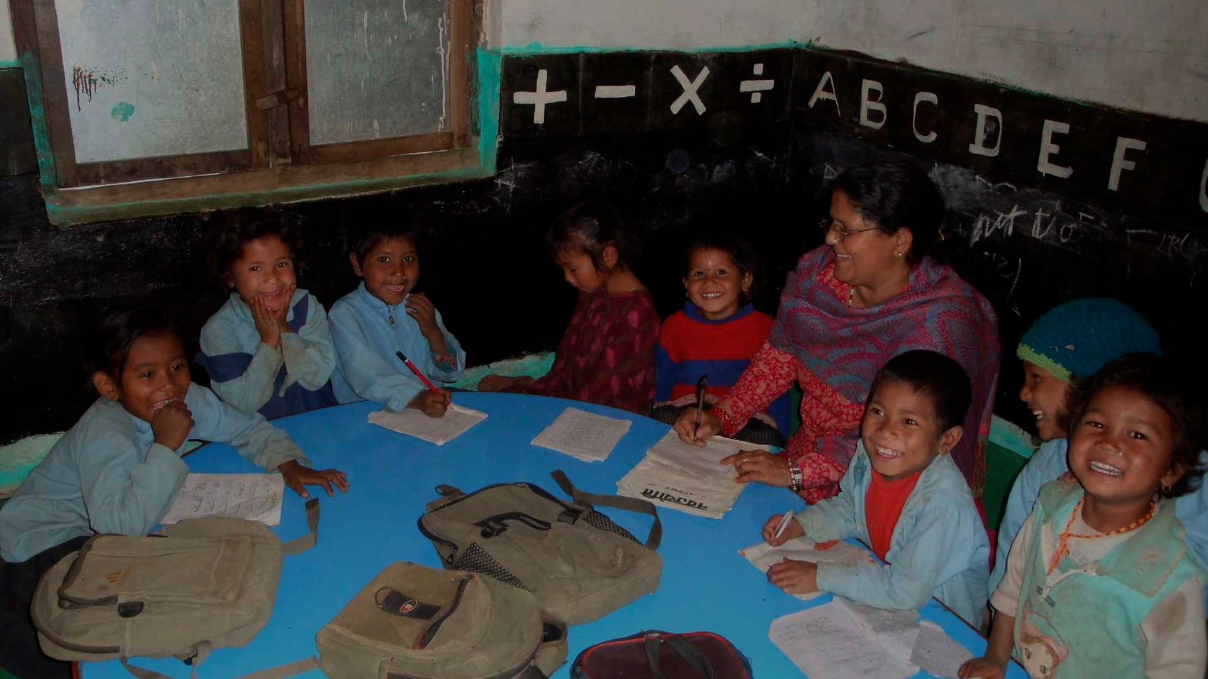
Positive Developments in MLE cont.
UNESCO Advocacy Kit for promoting MLE
Establishment of MLE Advisory Committee
MLE Resource Centre
MLE Programs
6 x Pilot MTB-MLE in 6 districts: Ministry of Education
8 x MT languages 2007-2009
5 x MLE Projects:
  INGO x 2 working in four MT languages
  NGO x 4 working in six MT languages

Slide 8
Changes in Limbu and Tharu schools
Low dropout: students are more interested
Higher learning achievements: Students are openly sharing their ideas
Positive Change: parents and teachers are more interested to use mother tongue as a Medium of Instruction
Supportive Role: Parents and teachers are supportive of developing MT teaching and learning materials
Raising Awareness: Communities are more aware and supportive
Conceptual Clarity: Parents are accepting that MLE will help develop and preserve their identity by using their language and culture

Slide 9
Key benefits of MLE
Rational for MLE
Multilingual education is practical and based on scientific research-based evidence.
"Strong forms of bilingual education can be an economically valuable policy. Repetition and dropout rates are decreased, and a more ‘skilful, highly trained and employable work force’ is produced.”
Colin Baker, Foundations of Bilingual Education and Bilingualism 4th Edition

Slide 10
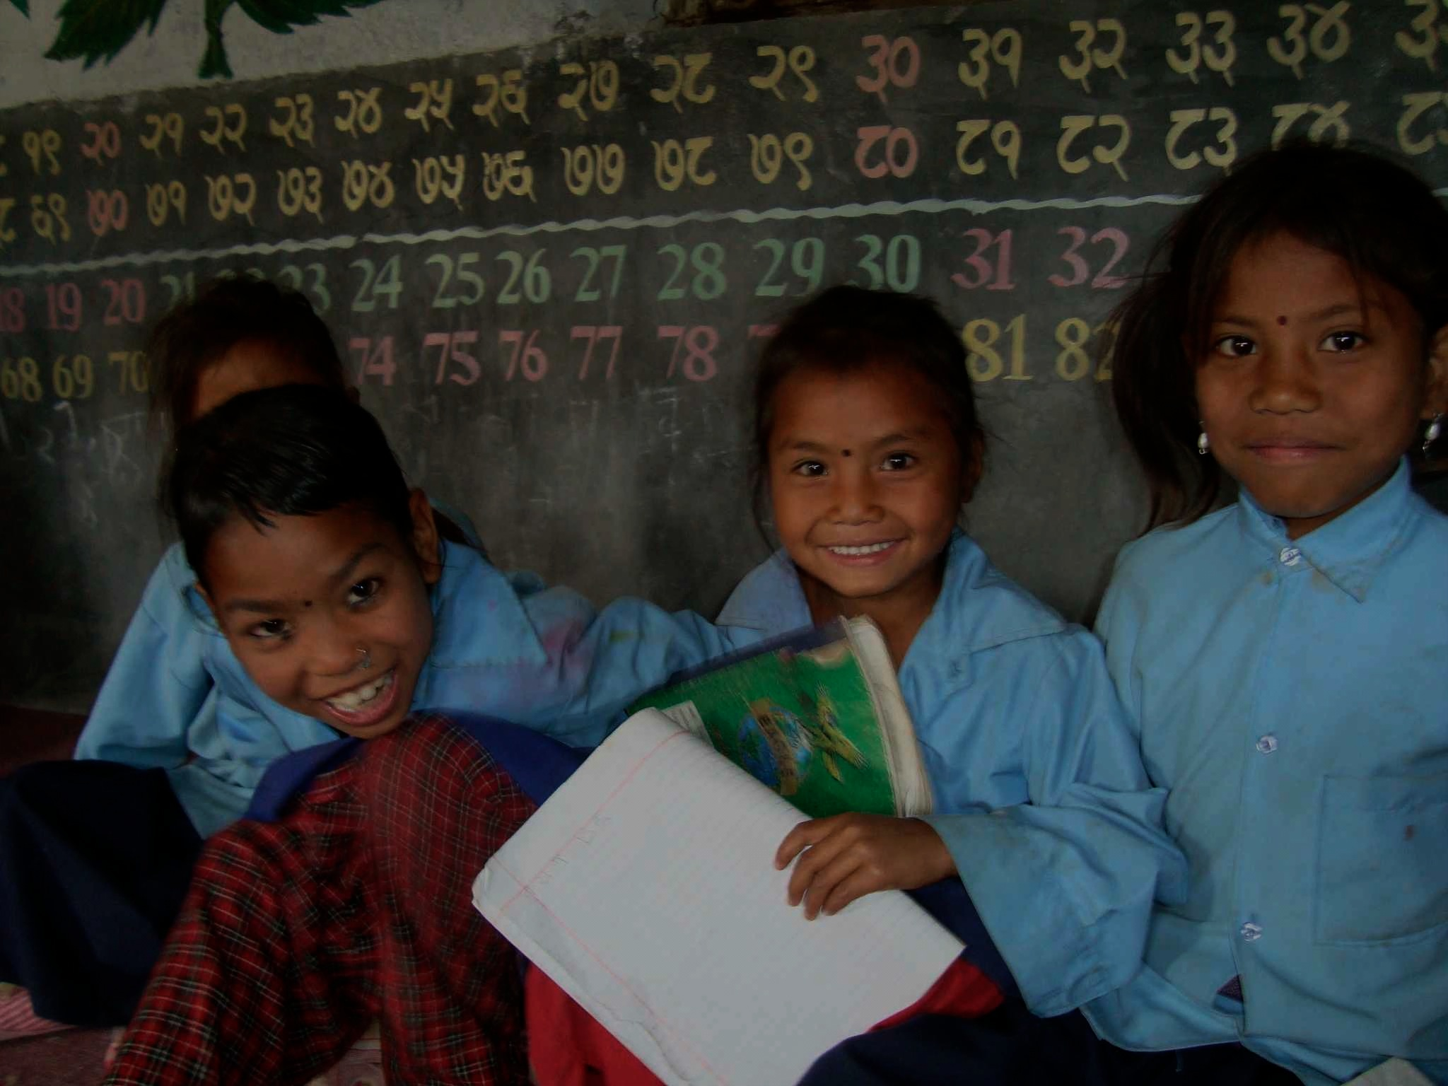
Key benefits of MLE cont.
Children/Schools
Children will have effective life-long learning skills
Give students easier access to contextual learning materials
Children will be able to maintain links with their family and community's values, cultural backgrounds and identity
Children will have better opportunities and be able to share a wide range of cultural experiences

Slide 11
Key Benefits of MLE cont.
Society
"The ability to speak the mother tongue as well as the national language and international language creates a much wider range of life choices for individuals but can also achieve national unity." (Colin Baker, 2006)
MLE will help to create positive thinking between the individual and society and produce good and productive citizens
Achieving educational goals will help peace building and lead to a harmonious environment in the community
People will be able to create employment & Business opportunities

Slide 12
Key concerns and challenges
Gaps in Plans, policies and implementation
Political instability: Nepal is in a political transition situation since the April 2006 revolution.
Parents are loosing faith in Government (Community) Schools: Only 28.19% students passed School Leaving Certificate (SLC) 2014 from government schools.
English Medium Schools: Teachers and parents believe that English medium education is necessary for better employment
Confusion about Medium of Instruction: What and why MLE? ... are not convinced importance of MLE in basic education.

Slide 13
Key concerns and challenges cont.
MLE as a Slogan: MLE is used as a political slogan rather than an academic and pedagogical term and attitudes of parents, teachers, education activists & specialists, political leaders, and government officials are not supportive towards implementing effective MLE.
To meet these challenges, the state (government) must ensure that government and private schools operate under the same policies and system with supportive and effective regulation and monitoring.
Linguistically diverse societies: How will we implement MLE in a multiple language situation in one classroom?

Slide 14
Key concerns and challenges cont.
Writing system of language and its script: Most of the minority languages in Nepal are only spoken and not written.
Kabindra Newang, Head Teacher comments "In our context if we use different script rather than Devanagari script children will have to learn three scripts, Mother tongue- Sirijonga script for Limbu, Devanagari script for Nepali and Roman script for English at a same time and they feel more stressful situation to learn read and write”.
Curriculum and contextual teaching and learning materials: There is no MLE curricula and textbooks for students. Nepali language is a medium of instruction in all classes. English and minority languages (mother tongue) are taught as a subject.

Slide 15
Key concerns and challenges cont.
Teacher training and support system: Teachers are unable to teach students in their mother tongue due to their lack of training and the difficulty of switching from the local language to Nepali and English.
Monitoring and Evaluation of teacher’s performance: There is no effective system to support, monitor and evaluate the teacher's performance.
Student’s Evaluation System: Using mother tongue as a medium of instruction and not using mother tongue for evaluating performance in exams.

Slide 16
Key concerns and challenges cont.
Low Literacy rate of parents: The average literacy rate in Nepal is only 65.9%. Male literacy rate is 75.1% and female literacy rate is 57.4%.
Poor coordination and networking among the stakeholders
Impact on Language, Culture and Religion: How will MLE address these questions?
a. How does MLE address the linkage between language, culture and religion representing the identity of the people and their community?
b. How do minority language speakers preserve their culture if they change their religion, does it make any difference?

Slide 17
Opportunities
Civil society organizations can demonstrate good MLE models to assist the government in designing education programs
Pilot MLE schools can become a resource to other schools
Revision of the national curriculum to include MLE competencies
MLE can play a key role in maintaining and strengthening local languages and culture
INGOs and national NGOs can assist local organizations to support and implement MLE in their respective communities in coordination with government agencies.
Sharing experience of MLE among our various stakeholders – parents, language communities, I/NGOs and GOs

Slide 18
Steps for effective and sustainable
MLE in Nepal
Long-term education plan:
Our focus must be to long-term (50 years) national plans with strong strategic and implementation guidelines guided by an inclusive national language policy
Revisions to the National Curriculum framework 2006:
Ensure using mother tongue as a medium of instruction in pre-primary and primary grades of basic education
Language Progression Plan
Ensure policies show a clear language progression plan for students who do not speak Nepali as their first language to learn Nepali and for all students an international language (English)

Slide 19
Steps for effective and sustainable
MLE in Nepal cont.
Language Progression Plan cont.
Education policies must include
Enabling teachers to use local, national and international languages as mediums of instruction
Developing a language progression plan and school-based curriculum and textbooks
Supporting the development, if necessary, of writing system for languages that do not have one.
Supporting the development of writing system for languages

Slide 20
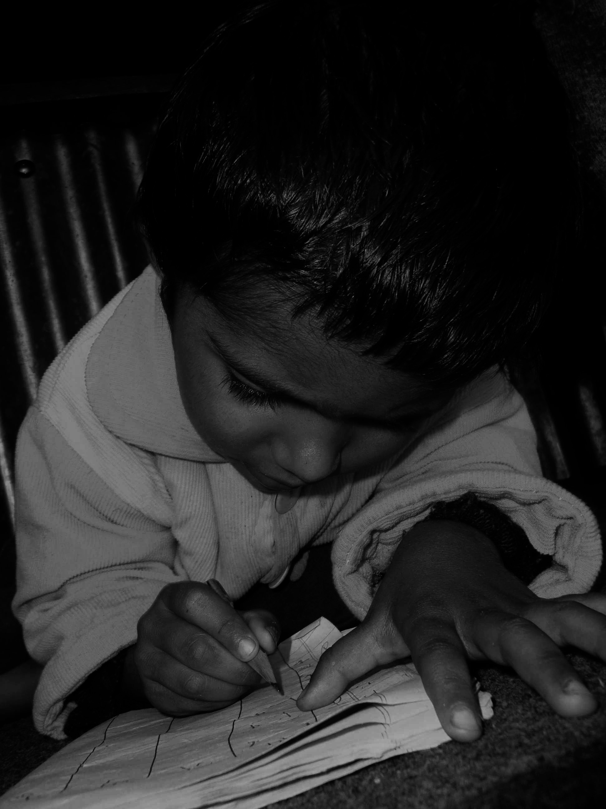
Steps for effective and sustainable MLE in Nepal cont.
Education policies must include cont.
d. Enabling students who begin their education in a language other then Nepali to make a good transition to Nepali. Their languages should be written in Devanagari script.
We need to work together find a way to use Devanagari script with some modifications to write minority languages. Good examples and practices will help to convince language activists and language communities to accept the benefits of using Devanagari scripts in the early grades in basic education.

Slide 21
Steps for effective and sustainable
MLE in Nepal cont.
Standard and contextual textbooks
Publication of standard textbooks with contextual content & for each subject. Student must be taught their MT as a subject
Teacher recruiting and training system
Develop & establish a recruiting and training system that produces qualified, capable, competent & committed teachers. Good teacher should be rewarded & poor teacher either retrained or withdrawn from schools.
Community school capacity building activities
Establish training & empowerment program for school administrators & school management committees to give the local community a grater control over their own schools as envisaged by the Ministry of Education community school policy.

Slide 22
Steps for effective and sustainable
MLE in Nepal cont.
Continuous Assessment System (CAS)
Implementing a Continuous Assessment System for students as soon they enroll.
Continue advocacy
Promote local, regional and national as well international networks to advocate for effective and sustainable MLE
"You do not say there are too many languages in the world. Languages are Keys to knowledge. The more languages you know, the more keys you have. If you know all the other languages and don't know your language that is called enslavement. If you know your language and add all the other languages, that is called empowerment." (Ngugi Wa Thion'go 23 July 2012, Red Africa Launch, Lagos)

Slide 23
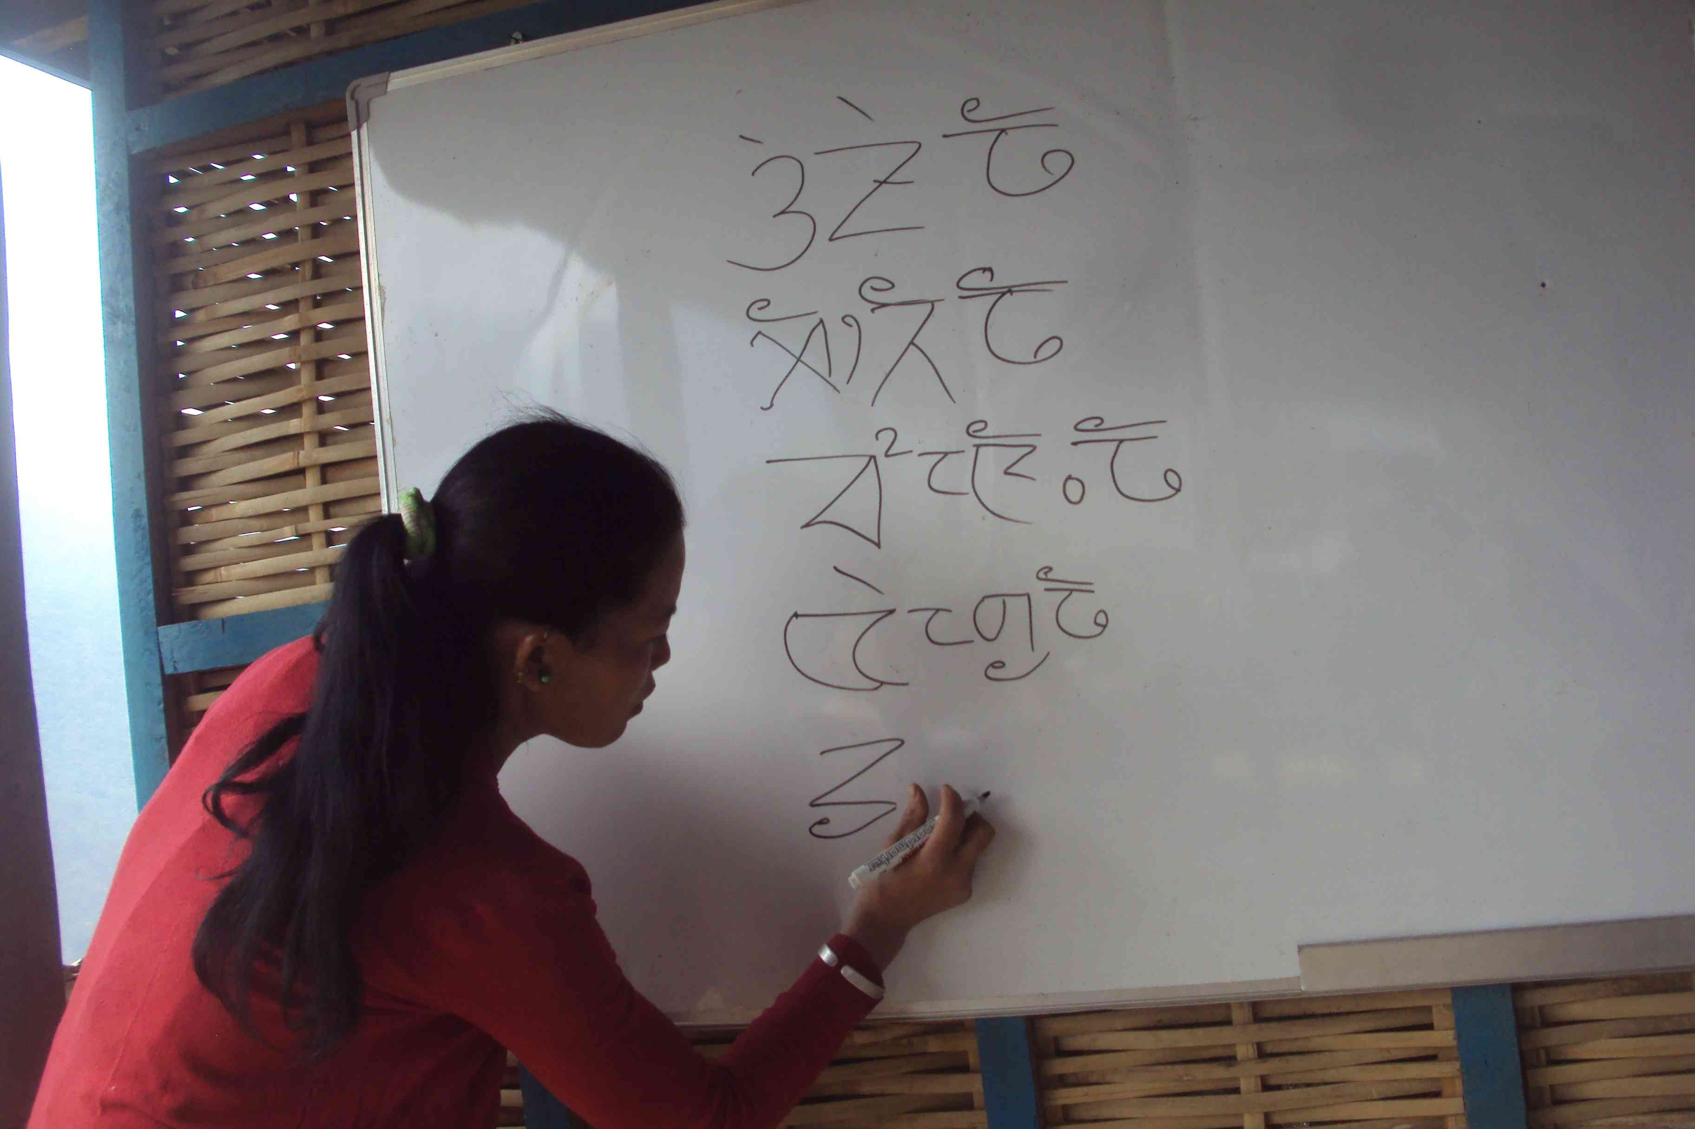
Steps for effective and sustainable MLE in Nepal cont.
Model MLE programs: Region, Zone, District and Constituency
Promote one education system
Encourage private schools to teach student’s MT as a subject & ensure private schools to use the same curriculum as government schools. If government school can demonstrate excellent learning outcomes of student using their mother tongue as a Medium of Instruction this will stimulate private schools to use MT as a MoI.
Transitional literacy projects for parents (Mother Tongue-Nepali-English)
Literate parents are better able to support their children’s education. The government should provide transitional literacy learning opportunities to parents who request them.

Slide 24
Conclusion
A. MLE: First priority in early grades of basic education to
  1. Develop a child friendly environment
  2. Ensure quality education for all
  3. Achieve good learning environment
B. Advocacy and Capacity Building
    1. Continue advocacy for positive and active participations of stakeholders
    2. Improve school facilities & develop capacity of local communities
    3. Training to school management committee
    4. Teacher training and coaching: quality teacher
C. Coordination, monitoring and evaluation from Government
    1. Develop effective monitoring & evaluation mechanisms to improve teacher’s performance
    2. DoE plan and make strategies to work with I/NGOs

Slide 25
The use of mother tongue in Basic Education as a means to providing a strong foundation leading to quality education remains a great challenge in Nepal.
We know the importance of mother tongue in education. Experts have also agreed on the usefulness of MLE to provide quality education for all. But the use of mother tongue (MT) as a medium of instruction for students is an issue of debate among the stakeholders.
Nothing is impossible. We will have to make honest involvement and work together to reform our education system. We reformed our political system but our attitudes are same as before because we are product of existing education system. So, we are not getting successes to change our attitudes and behaviors. It will only be possible if we reform our education system as our sociopolitical changes.
We need to feel good about our work and be ready to accept constructive criticisms so that we can improve our working strategies for the sake of the children and the betterment of our nation (Nepal) to make the slogan “Quality education Transform the nation” becomes a reality.
धन्यवाद Xiexie Thank You

