Slide 1
A surfeit of –isms: Languages in Kenyan education
John Lowe
School of Education
University of Nottingham Ningbo China

Slide 2
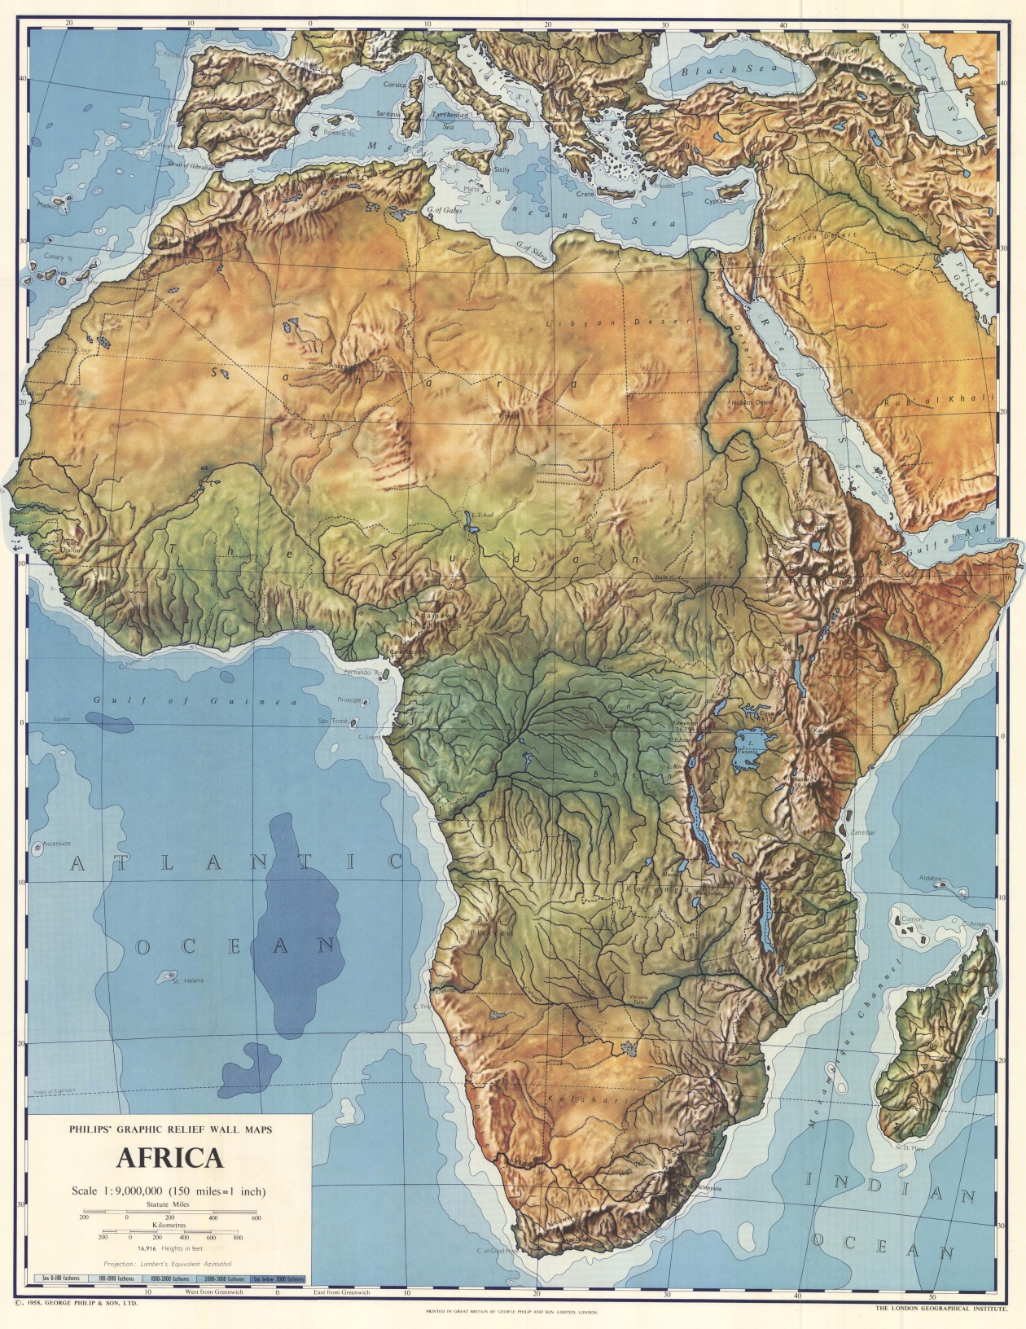

Slide 3
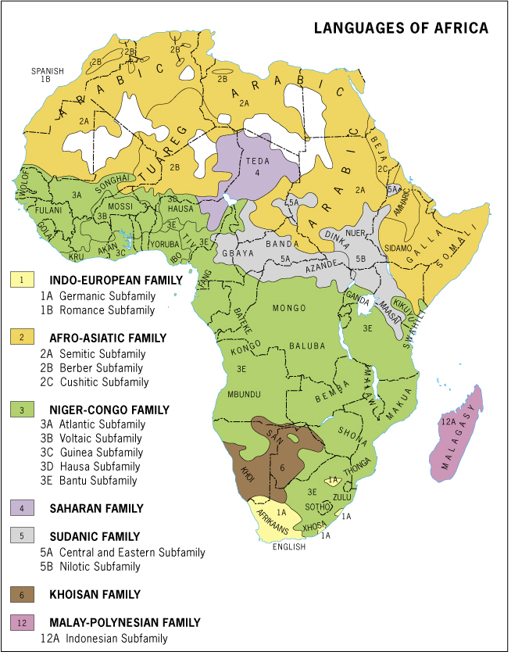

Slide 4
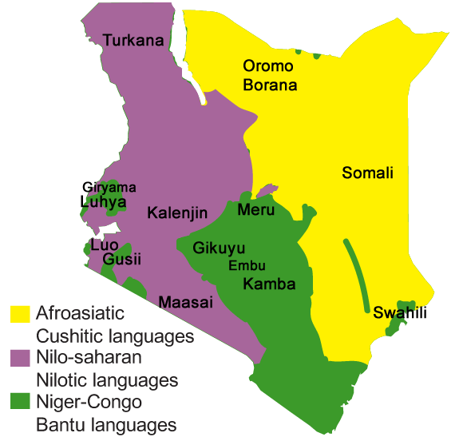

Slide 5
Kenya
~ 46 million people
67 (42?) languages
3 dying, 3 in danger, 14 ‘institutional’
2 ‘national’ languages – Swahili and English

Slide 6
Colonialism
British colony
English as the ‘official’ language
(Not an ‘inevitable’ choice)
Limited availability of a lingua franca
Limited English-speaking ‘low-level elite’
L1 for oral instruction, English from early primary school. Swahili policy inchoate.

Slide 7
Independence (1964)
Nationalism and ‘nation building’
Regionalism/Pan-Africanism
Tribalism as potentially dividing
Commission-ism
English as ‘official’ language; Swahili as ‘national’ language
English remained supreme in education
Local languages and Swahili – fluctuating fortunes and usage
Not a truly multilingual education

Slide 8
Today
‘Globalism’
Post-colonialism/ neo-imperialism
Neo-liberalism and elitism
English and Swahili both ‘official’ languages
Growing ‘urbanism’: multilingualism, linguae francae, ‘Sheng’

Slide 9
Education policy today
Rural schools
P1 – P3: L1 as MoI; English and Swahili as subjects
P4 onwards: English as MoI and subject; Swahili as subject; no L1
Urban schools
P1 – P3: Swahili as MoI; English as subject; No L1
P4 onwards: English as MoI and subject; Swahili as subject; no L1

Slide 10
Some issues
(partly drawing on Nyaga and Anthonissen, 2012)
A: Class 1, urban, 32 children, 11 L1s (including English and Swahili), teachers’ 2 L1s
B: Class 1, rural, 44 children, 3 L1s (not English or Swahili), teacher’s L1 not shared with children
C: Class 1, urban (private), 21 children, all with English and Swahili as L1s, some with other ‘semi-L1s’, one teacher with own L1, Swahili and English, one teacher with English only

Slide 11

Thank you
Asante
谢谢
Observations, questions, further discussion, proposals for joint research* …
John.Lowe@nottingham.edu.cn
* Particularly encouraged from anyone with a large research grant

