Slide 1

Constructing Effective Mental Models in Essay Writing: Strategies for Training
Bilingual Chinese-English Majors
Leshan Teachers College
Luo Mingli
Ningbo • China 2014-11-29

Slide 2
Outline
Background of the Study
Literature views of the study
Mental models on essay writing
Mental models: …
Mental models and Writings
Steps to Constructing Mental Models
Constructing Mental Models: …
Essay Writing and Planning
Effective Writing training
Summary and Discussion

Slide 3
Background of the Study
difficult to write English essay
the TEM-4 and TEM-8
“three-part argumentative writings”
a dynamic and interactive process
critical thinking
creative thinking
the language systems
cultural backgrounds
thinking patterns

Slide 4
Background of the Study
Use Chinese thinking patterns and structures to express their ideas
lack frequent and sufficient writing practice in English
errors in the writing of TEM-4:
reflected in the structure of the composition, there is not a perfect structure nor a cohesion” (Jinyan Fan, 2008 )

Slide 5
Background of the Study
The typical writing errors in the TEM-8:
1) the argument is not fully expanded;
2) the structure is not rigorous;
3) the beginning and end part are not in agreement with each other or self-contradictory;
4) the essays lack coherence and logic (Jie Liu & Hong Chen, 2006).

Slide 6
Background of the Study
The errors from some students’ essay writings:
Sample 1
Sample 2
Sample 3
Sample 4

Slide 7
Background of the Study
students very much like to shift the pattern of Chinese narrative writings to English argumentative writings (Luo Mingli, 2012).
“With the development of China’s economic, we can now see there are many advertisements on TV.”
This sentence cannot be regarded as the topic sentence, for it does not contain a theme—rheme structure, which is the “basic form of the organization of the clause as message” (Halliday, 1985), and the “basic unit of language in use is not a word or a sentence, but a text” (Halliday, 1970).

Slide 8
Background of the Study
Students’ Essay Writing
Obviously lack the unity of form and meaning, does not reflect the author’s views and ideas （Mingli Luo, 2008）
transferring Chinese thinking modes to express their ideas in English (Mingli Luo, 2009)

Slide 9
Background of the Study
both teachers and students ignore the importance of planning before writing (Mingli Luo, 2012):
1) their writings are not argumentative;
2) their expressions are Chinese-like, without logic, and with many grammar mistakes;
3) the form of their writing is not in agreement with their meaning;
4) the viewpoints or ideas of students cannot be found in their writing.

Slide 10
Background of the Study
nearly eighty-five percent of his students do not have the habit of planning before they write (Mingli Luo, 2012).
Paragraph structure is loose, and improper cohesion, the layout is messy... ,
Students often use the logic way of thinking of Chinese construct English discourse structure to develop argumentative essays (Mingli Luo, 2011)

Slide 11
Literature Review: Writing Approaches
The Product Approach
mastery of a language is in speech production…by drills and repetition (Silva, 1990).
“content, organization, vocabulary use, grammatical use, and mechanical considerations such as spelling and punctuation” (Brown, 1994, p. 320).
Students memorize, imitate, copy and transform teachers supplied models
four stages for writing: familiarization, controlled writing, guided writing and free writing

Slide 12
Literature Review: Writing Approaches
The Process Approach
Focus on the development of language use; brainstorming, group discussion, and re-writing.
prewriting, composing/drafting, revising, and editing (Tribble, 1996).
the purpose and social context of the piece of writing (Badger & White, 2000)

Slide 13
Literature Review: Writing Approaches
The Genre Approach
the genre-based approach views writing as a social and cultural practice. This involves not simply teaching activities for a writing process, but also teaching the purpose of writing,
According to Cope and Kalantzis (1993), it consists of three phases:
1) the target genre is modeled for the students,
2) a text is jointly constructed by the teacher and students, and
3) a text is independently constructed by each student.

Slide 14


Literature Review: Scaffolding Theory
…support people who are constructing a building. The scaffolds are withdrawn once the building has taken shape and is able to support itself independently” (Christie, 2005).
“…‘scaffolding’ is its ability to capture the role of the ‘expert,’ or more knowledgeable other (typically the teacher), in assisting students’ learning, and the role of that knowledgeable other in extending students’ current levels of understanding or current capabilities.” (Hammond & Gibbons, 2001)
challenge and motivate students to construct and transfer new knowledge and understanding.

Slide 15
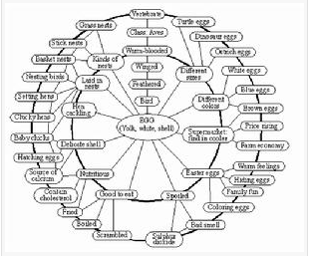
Literature Review: Schema Theory
Rumelhart (1980) further developed the schema concept and described schema theory as basically a theory of how knowledge is mentally represented in the mind and used.
Schema theory can help us to focus on the prior knowledge and experience, or mental schema, that students bring to …carry out and complete the particular learning task.
Mental model is significant in essay writing!

Slide 16
Literature Review: Memes Theory
Memetics based on Darwin’s Evolution .
Memes are the units of communicating language and culture. Imitation is the core of memetics.
From the perspective of memetics, language memes have implications for college English writing teaching (Liu Yuehui, 2011).
Memetics to teaching of English writing can help students construct knowledge and develop skills of writing by recitation and imitation of language memes (Xu Jing, 2014).

Slide 17
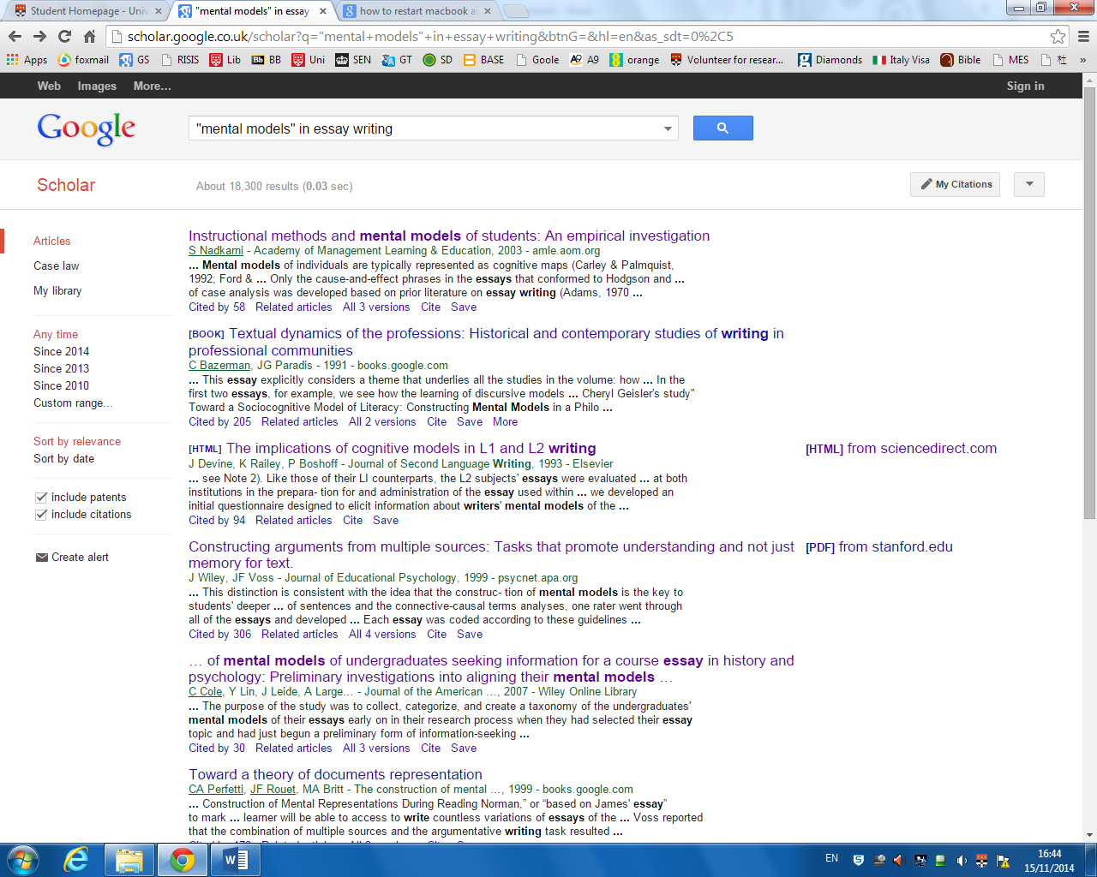


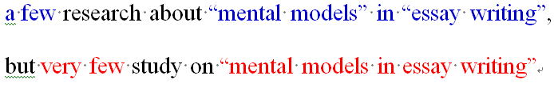
Mental models on essay writing

Slide 18

Mental models on essay writing

Slide 19
Mental models on essay writing

Slide 20


Mental models on essay writing

Slide 21


The Author’s Study on Essay Writing
Thinking ⇒ Planning ⇒ Constructing

Slide 22



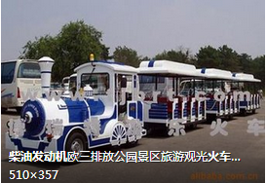
Mental models: trains?

Slide 23
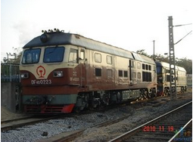
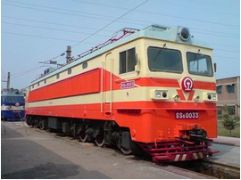
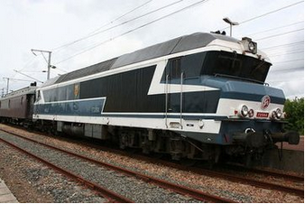
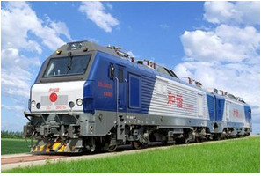



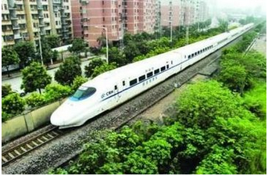
Mental models: trains?

Slide 24
Mental models: trains
styles
ages
trains
powers
development

Slide 25



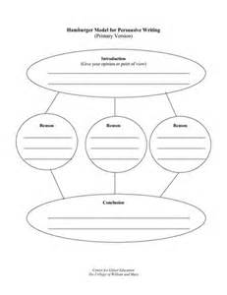
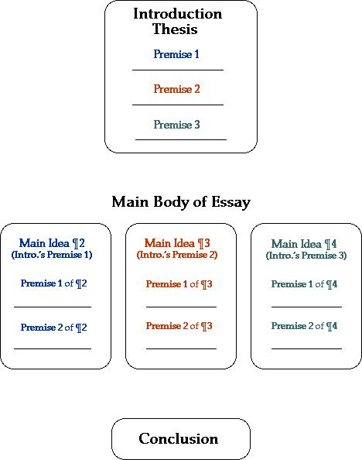
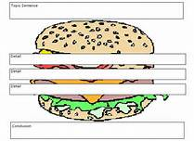
Mental models: hamburgers?

Slide 26
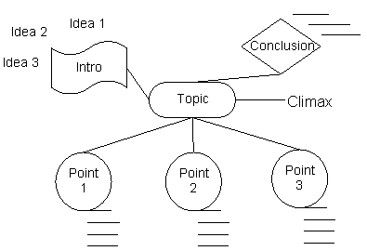
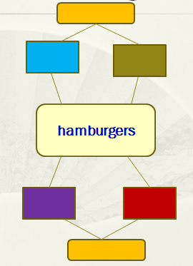
Mental models: hamburgers
Constructing the mental models in essay writing

Slide 27
Mental models and Writings
From concrete to abstract
From general to specific
From objective to subjective
From perceptual to rational
From deductive to inductive
from logic to reasoning
From form to meaning
From symbol to text
Form process to product
From explicit to implicit
From deductive to inductive
From conscious to subconscious
Language instruction
Language cognition
Language use
Awareness of writing between writers & readers

Slide 28
Mental Models in Essay Writing
Innovating
Memes Theory
Freeing writing
Criticizing
Generating
Controlled writing
Schema Theory
Internalizing
Guided writing
Imitating
Scaffolding Instruction
Blank-filling writing

Slide 29
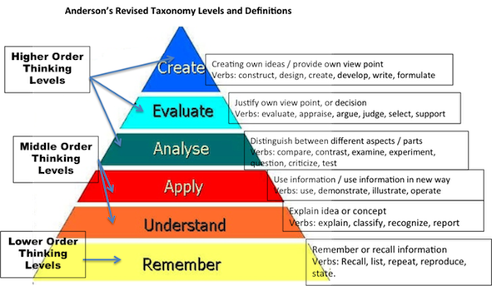
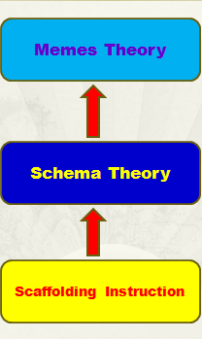
Mental models and Writings

Slide 30
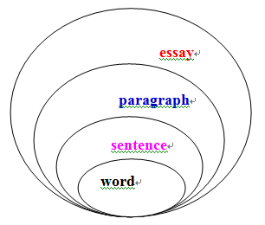
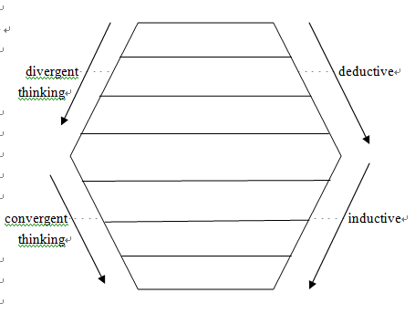
Steps to Constructing Mental Models
Reducing the “translation in mind”
Down-up & Up-down

Slide 31
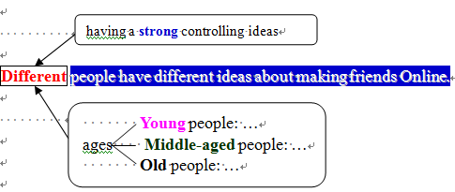
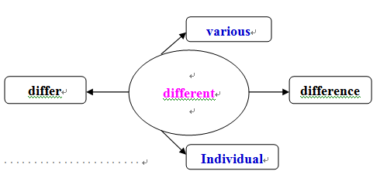
Steps to Constructing Mental Models
Word levels

Slide 32
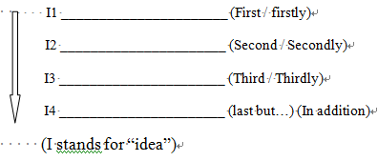
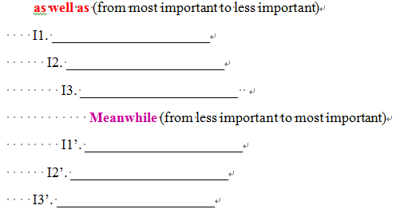
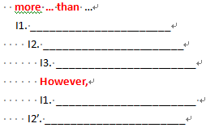
Steps to Constructing Mental Models
Paragraph levels

Slide 33
Steps to Constructing Mental Models
Text levels
The theme
analysis
author’s idea
evidence 1
evidence 1
evidence 1
evidence 2
evidence 2
evidence 2
author’s idea
(reasons, examples…)
retell the theme
1st part
2nd part
3rd part
Generally
In detail
Generally

Slide 34

Steps to Constructing Mental Models

Slide 35
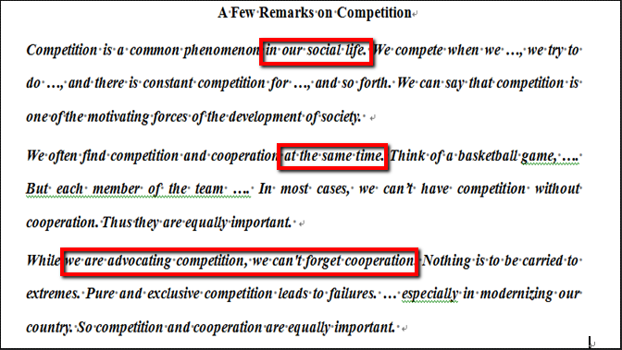
Constructing Mental Models: Blank-filling Writing

Slide 36
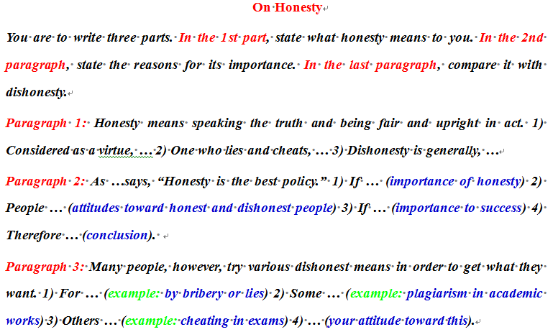
Constructing Mental Models: Guided Writing

Slide 37
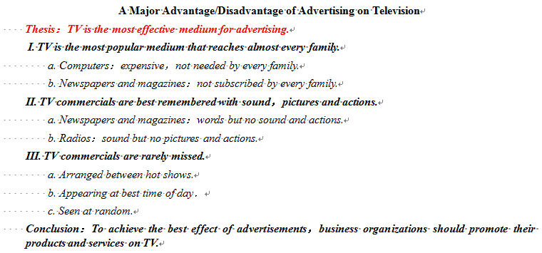
Constructing Mental Models: Controlled Writing

Slide 38
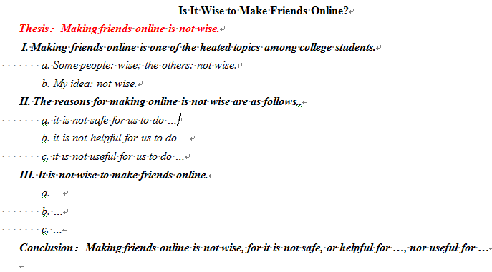
Constructing Mental Models: Controlled Writing

Slide 39
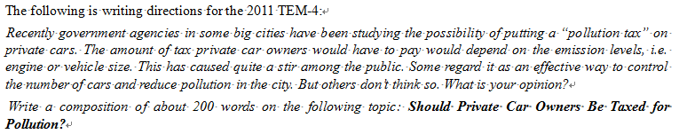
Constructing Mental Models: Free Writing
This test is not so difficult for Chinese-English majors to write well, for this kind of topic is very familiar to them.
If English writing teachers, as usual, give students some topics like The Choices of Transportation: Bicycles or Private Car? Or My ideas about Environment Protection Or My Suggestions about Tax, and so on, students can easily construct their thesis, writing logic, controlling idea, writing frame, topic sentences, supporting sentences, and concluding sentences as well as paragraph development, and language expressions.

Slide 40
Essay Writing and Planning
Competent writers go through complex processes which combine generating, planning, and translating ideas into written form, and which also include rethinking those ideas and revising and editing the style in which they are presented. (Jeane W. Halpern, 1980)

Slide 41
Friendship between all human beings
Frame work of the essay
Friendship between familiar people
Language cognition
Friendship between close friends
Friendship exists everywhere
My Understanding of Friendship

Slide 42
Summary and Discussion
writing models ≠ writing template (模型≠模板 )
Schema ≠ Graphics (图形≠图式)
Imitating ≠ copying (仿写≠抄写)
Critical thinking ≠ creative thinking (批判性思维≠创造性思维)
free writing ≠ writing freely (自由写作≠随意写作)

Slide 43
Aims to Construct Mental Models in Essay Writing
teach students to know what to write
train them to understand how to write well
foster students’ awareness of critical thinking
develop students’ creative thinking

Slide 44
Thanks!

