Slide 1

Localisation and Globalisation in Family Language Choice in Taiwan: Reflections of Wider Discourses
Yi-Ling (Rene) Chen

Slide 2
Outline
Language Policy in Taiwan
Family Language Choice
The Case Study
- methods
Discussion
Conclusion

Slide 3

Taiwan: Languages (and a bit of politics)
- 17th century
- 1895-1949 : Japanisation
- Post-1949: Sinofication
- From 2000

Slide 4
Tension between Localisation and Globalisation in Taiwan
Language Policy in Taiwan
Mother-tongue education
in 2001
English language education
from 1968 to 2000
in 2001
in 2004
in 2005

Slide 5
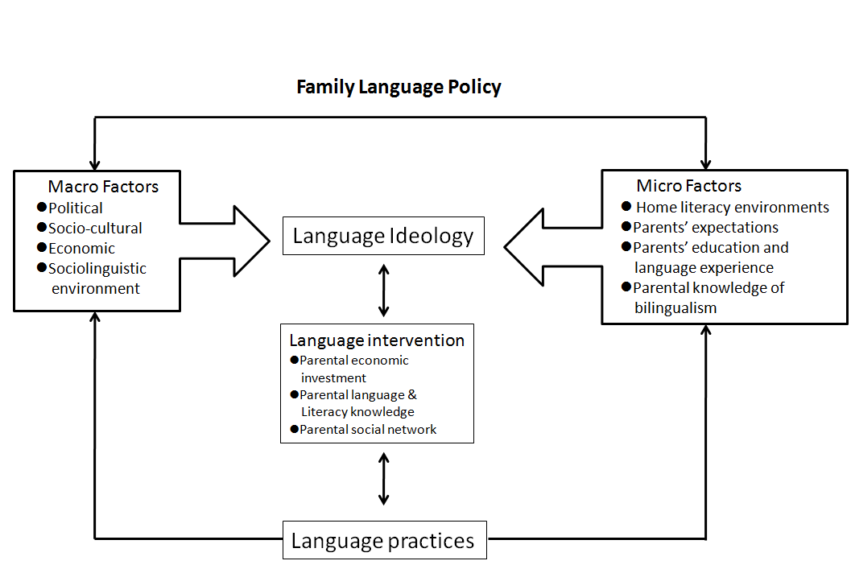
Family Language Choice
Curdt-Christiansen (2009)

Slide 6
The case study in Taiwan
The function/role of languages?
Parental ideologies?
Underlying factors?
Language management and language practices?

Slide 7
Methods
Questionnaire
Interview
Choices of cases

Slide 8
Quotes
It’s not necessary to learn Hakfa because only a few people speak it. Her mother and I both speak Minnan and we prefer her to learn Minnan because at least it’s practical in the labour market.
I told him that we have to work hard because we didn’t learn English well, nor did we go to university. Our jobs are more tiring than others and we don’t want it happens to him in the future. I want him to be better than us and work more easily than we do. English ability and an undergraduate degree are requirements in the future when he grows up. I want him to build good foundation of English learning to benefit himself in the rest of his life.
It (mother-tongue education) lacks worldwide views. The world emphasises English learning greatly and we emphasis mother-tongue teaching. It is small island mentality and the government is not aware of the global trend.
Only literate people speak Mandarin in our generation. Speaking Mandarin makes people think (the speaker) is from higher class. So we speak Mandarin to our children unconsciously.
We speak Mandarin to children most of the time because it is the medium of instruction. I don’t want to confuse her and influence her school work by learning too many languages at the same time. No one speaks Hakfa now and she can always pick up Minnan in the future.

Slide 9
Discussion
Functions of different languages in Taiwan
 | Instrumentalism | Status | Culture/ Communication/ Political | Daily life
Mandarin | ✔ | ✔ | ✔ (national) | ✔ (national)
English | ✔ | ✔ | ✔ (global)
Minnan |  |  | ✔ (local) | ✔ (local)
Hakfa

Slide 10
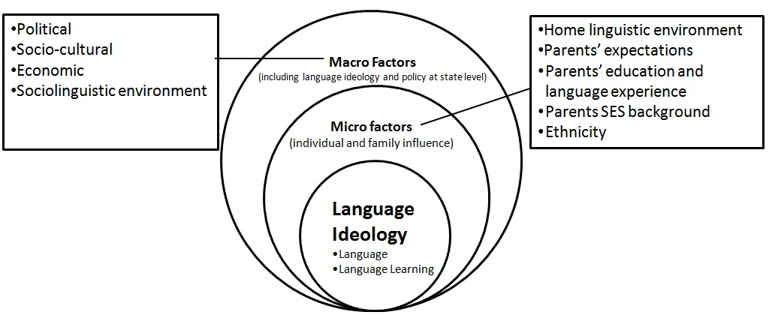
Conclusion

Slide 11
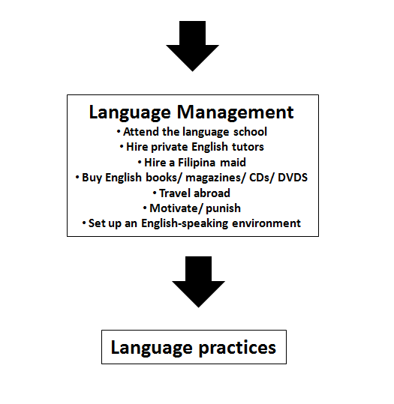

Slide 12
Yi-ling (Rene) Chen ylchen@nhu.edu.tw

