Slide 1

Trilingual Education in Context: Towards a Comprehensive Framework for Research
Anwei Feng
University of Nottingham Ningbo China
Email: anwei.feng@nottingham.edu.cn

Slide 2
Outline
Major insights gained from Trilingualism-in-China project
  The concepts of ‘additive trilingualism’
  Models in trilingual education (strong vs weak)
  Contextual factors that determine the forms of trilingual education such as:
    Policies
    Ethnolinguistic vitality
    Attitudes to and perceptions of trilingualism and languages in education
    Sense of ethnic and national identity
    Socio-political situation …
A methodological framework for researching language provision for minority groups

Slide 3
Outcome of TE
Broadly, we could group the ‘end-products’ of trilingual education into three categories with regard to their competence in the three languages under study:
Balanced trilingualism – those who can speak and write in all the three languages equally well. Balanced trilinguals exist, but are extremely rare
Additive trilingualism – (see next slide)
Subtractive trilinguialism – (see slide after next)

Slide 4
Additive Trilingualism
(development in pupils of) very strong competences in L1 (pupils’ home language) and L2 (Mandarin Chinese), given L2’s wide use and absolute importance for life opportunities in China, and peer appropriate competence in L3 (a foreign language, usually English). Peer appropriate competence in L3 means oral proficiency and literacy in L3 comparable to that of the peers of the majority Han group.
  Note: Theoretical bases – bilingualism and cognition; threshold theory (the somewhat vague notion of ‘very strong competence’ could be seen as equivalent to native speaker competence in L1, however it is defined, and ‘CALP’ in L2 (Cummins, 2000))
  Also note: Native speaker competence in L1 may refer to both oral and literary abilities, but it may also refer to oracy only in cases in which the written script of L1 does not exist.

Slide 5
Subtractive Trilingualism
(a situation in which minority pupils acquire) competence in L2 (Mandarin Chinese), limited or strong, and perhaps very limited competence in L3 (usually English) at the expense of their L1 (home language).
  In this situation, L1 may be under threat/pressure to be replaced by L2 where the latter is not only taught as a school subject but used as the medium of instruction.
  This may lead to loss of cultural or ethnic identity, low self-esteem, and marginalisation.
  Both concepts are defined as such on the basis of the literature on bilingual education and bilingualism.

Slide 6
Strong Models Identified
Models to foster additive trilingualism
  Accretive model
    Aiming to develop strong L1, and then L2 and then L3; to improve all performance.
    Outcomes: L1 maintained, identity confidently claimed, overall academic performance good (or improved)
  Balanced model
    Aiming to develop both L1 and L2 with required L3 competence
    Outcomes: L1 & L2 strong, ethnic identity and harmony
  Features:
  Area with high ethno-linguistic vitality of L1
  Using L1, or both L1 and L2, as MoI (in places where one minority group dominates or two groups are mixed)
  Stronger sense of ethnicity and presence of L1 and L2 languages and cultures in schools and societies
  Given favourable conditions, L3 is promoted robustly as school subjects

Slide 7
Weak Models
Models leading to subtractive trilingualism
  Transitional model (usually by shifting from L1 to L2 as MoI early)
    Aiming to use and learn L2 only
    Outcomes: eventually subtractive trilingualism
  Depreciative model
    Aiming overtly or covertly for monolingualism, ignoring L1
    Outcomes: subtractive trilingualism and linguistic and cultural assimilation
  Features
  May be mixed Han and minority groups or a single minority group where ethno-linguistic vitality is weak
  Pupils’ L1 is seen as useless or deemed useful only as a stepping stone in the first few years in schooling.
  (From onset or eventually) L2 used as MoI in classrooms

Slide 8
No Clear Borderline!
There is a continuum between the strong and the weak and between additive and subtractive.
(e.g., Transition models, if carefully designed, can be effective)
Many are aware that what model to adopt or develop is determined by numerous contextual factor including
  policy,
  ethnolinguistic vitality
  sense of ethnicity
  geography, demography, history
  other socio-economics
  ...

Slide 9
Trilingual Education in Context (TEiC)
Globalisation
    Ethnolinguistic vitality
    Local policy (Regional Attitudes/Perceptions
    or county level) Ethnic identity
    Assessment system (Influential)
    Individuals
    (Human) resources
    History
    Geography
  Demography Economy (e.g. tourism)
        Socio-political relationship
        with State
State Policy
Model of trilingual education for a specific minority region or school
Spread of
English
Models abroad
Research in the wider context
Notes:
If we put the most impactive factors in perspective, we may arrive at this graphic representation.

Slide 10
The Continuum
Additive Trilingualism ˂------------------------------˃ Subtractive Trilingualism
Policy with multiculturalism ˂-------------------------˃ Policy with (hidden) agenda
as guiding principle for assimilation
High ethnolinguistic vitality ˂---------------------------˃ Low ethnolinguistic vitality
Positive attitudes ˂--------------------------------------------˃ Indifferent attitudes
and clear insights and poor understanding
Active economy (tourism) ˂----------------------------˃ Lack of contact with other
Well-built sense of ethnicity ˂-----------------------------˃ Weak sense of ethnicity
Assessment that takes ˂-------------------------------------˃ Assessment that does multilingualism into account not
Notes:
When we analyse these contextual factors, we may become aware that many factors exist in continuum. Also we may observe that one end of the continuum, such as high ethnolinguistic vitality, is likely to bring about additive trilingualism while the other end, such as low ethnolinguistic vitality, leads to subtractive trilingualism.

Slide 11
Murky Waters!
There are limitations in the polarized terms, such as (strong vs weak; additive vs subtractive). The real world situation is extremely complex and relationships between the two extremes or between the different factors are often tricky and dynamic.
Tough questions may include:
Does strong ethnolinguistic vitality of L1 always lead to strong models?
Is a strong sense of ethnicity always encouraged or suppressed?
What if the minority group has no written script?
What if L1 of the minority group is Mandarin Chinese?
How should we deal with a situation where bilingual education means to promote L2 in a region for political purposes?
How come we seem to be using a strong model but the outcome still looks poor? …
For any meaningful policy or curriculum for trilingual education, all contextual factors need to be critically analysed in each region!

Slide 12
Less Explored Territories
In addition to the tough questions, there are many areas that are seldom discussed in the current literature and by researchers. They include:
How could the competence of a trilingualindividual and the effectiveness of a trilingual programme be assessed?
There is often a need to transfer from using one language as MoI to another (transition). How can we best do it in order not to lead to subtractive trilingualism? When is the best time?
In what way could the culture of a minority group be maintained and developed in order to avoid the reduction of culture to “Samosas, Saris and steel bands” (food, clothes and music, Coulby, 2006) or ‘Show Culture” (Feng, 2011).

Slide 13
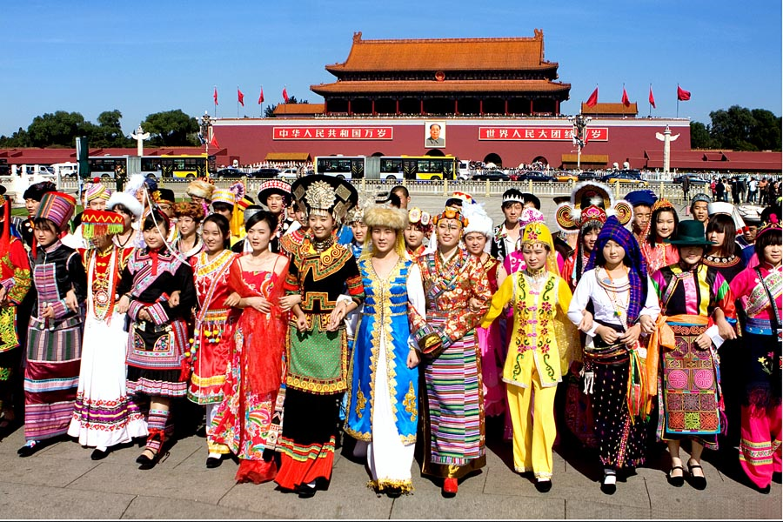
Images
1. ‘Look! How happy we are together!’
Notes:
For more a half century since the founding of PRC, the theme of the main propaganda photo to show ethnic harmony has remained the same. Mainly girls in minority costumes in front of Tian Anmen under the big portrait of Chairman Mao.

Slide 14
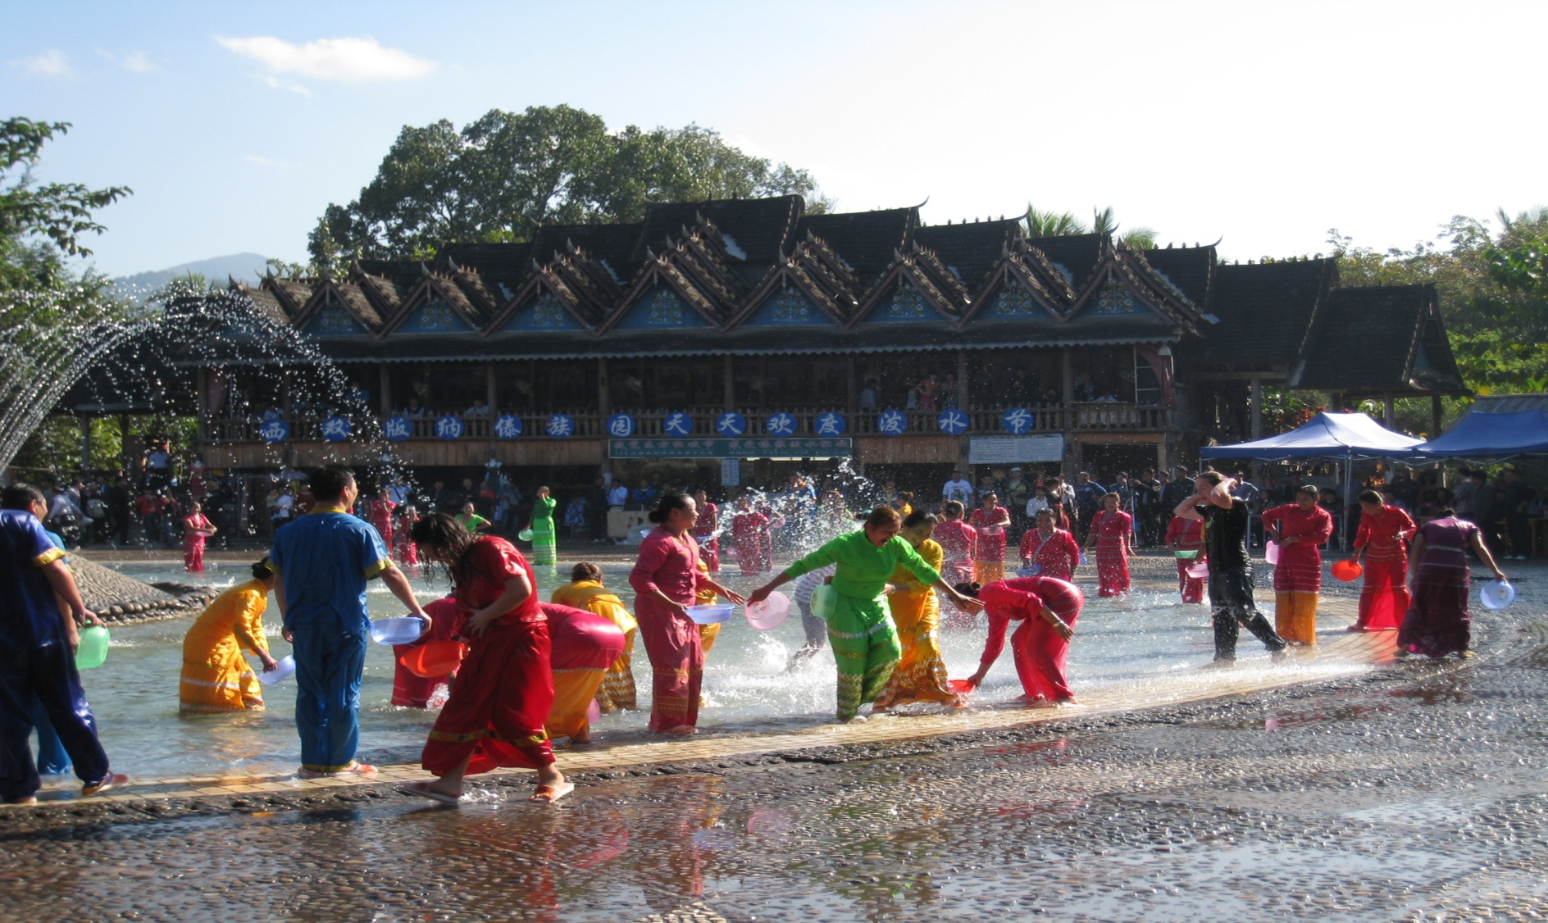
2. Dai Water Festival! Every Day!?
Notes:
In Yunnan(China), Water Splashing Festival is celebrated by the Dai ethnic group which is the one of the 55 ethnic minorities in China. The whole celebration usually starts in April 13 and it takes about 3–7 days. Traditionally people gently sprinkled water on one another as a sign of respect, but now some do it every day, for tourists!

Slide 15
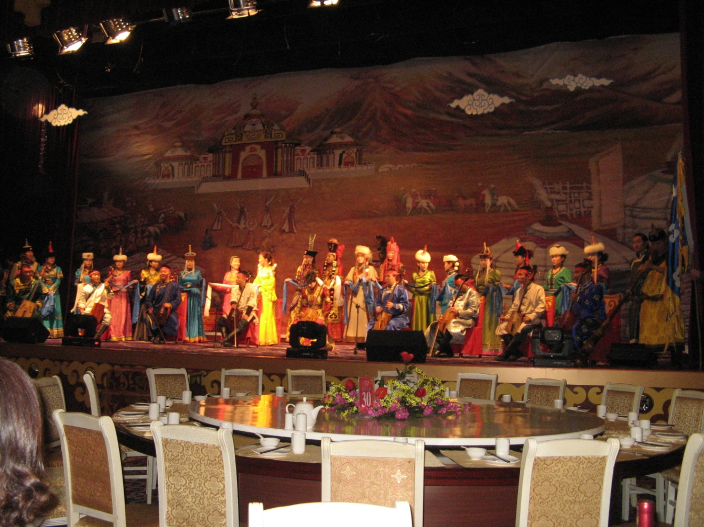
3. Cultural Show in Inner Mongolia

Slide 16
Ending Remarks
My arguments for the development of the notion of Trilingual Education in Context (TEiC) include:
We need to acknowledge the complexity of education research into language provision for minority groups.
No single research project could possibly produce enough valid and reliable data to lead to State or Regional policy making for trilingual education or for trilingual education curriculum design.
Trilingualism/multilingualism is applicable to all minority groups, but trilingual education makes sense only when we can adopt or develop the appropriate model for a specific group. And the most appropriate model comes from multiple investigations that are rigorous, valid and ethical!
  Comments? Question?

