Slide 1
TIPS ON LEARNING IN EMI COURSES
Dr. Choi, Tae Hee (choith@ied.edu.hk)
Mr. Cheung, Kwan Lok (kwanlok@ied.edu.hk)
Hong Kong Institute of Education

Slide 2
Agenda
I. Learning in Class
2. Writing Assignments
3. Useful Learning Resources
Appendices: Academic Writing
  Random tips on writing in academic style
  Where to look for supporting evidence
  Random linguistic strategies for academic writing
Notes:
A research conducted by Dr. Choi, Tae Hee shows that most students’ difficulty understanding course content was directly related to technical terms and abstract theoretical concepts. They claimed that in EMI lessons they couldn’t follow the teaching because they didn’t understand the jargon the teacher used and/or the concepts the teacher referred to. When those students revised course content for exams or assignments, they tended to spend a lot of time trying to understand key terms and/or concepts. Students’ struggles when learning through EMI also stemmed from the lack of academic writing training. Here, some random tips are provided to introduce some basic principles and conventions in academic writing. Due to the limited space, tips listed here are not meant to cover all aspects in EAP but are mostly information that allows different interpretations and thus provide opportunities for further discussion/elaboration.

Slide 3
Learning in Class: 1st tip
Read related reference materials before you attend a lesson
  Skim through abstract, headings & conclusion before you read the whole paper

Slide 4

Learning in Class: 2nd tip
Learn repeated terms (key concepts) before the lesson

Slide 5
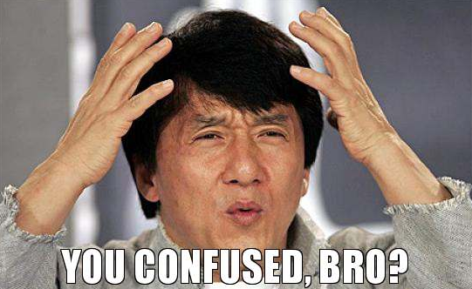
Approaching difficult words and key concepts: Using multiple sources
Example: Zone of proximal development
Vygotsky defined it as “the distance between the actual developmental level as determined by independent problem solving and the level of potential development as determined through problem solving under adult guidance or in collaboration with a more capable peer” (as cited in Graue, 1993, p. 29)
Notes:
Sometimes definitions in reference books are opaque that students may find it hard to comprehend. An example is provided. (It will show up when the full-screen mode is turned on.)

Slide 6
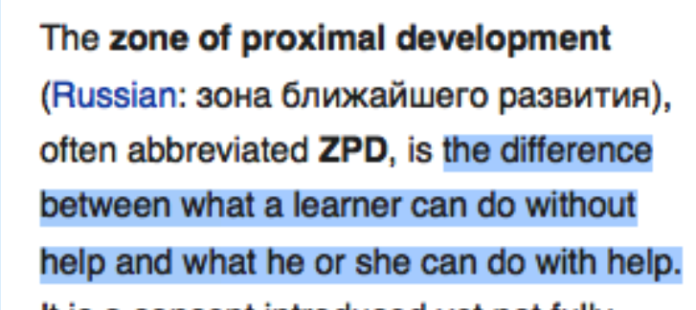
Approaching difficult words and key concepts: Using multiple sources
1. Wikipedia

Slide 7
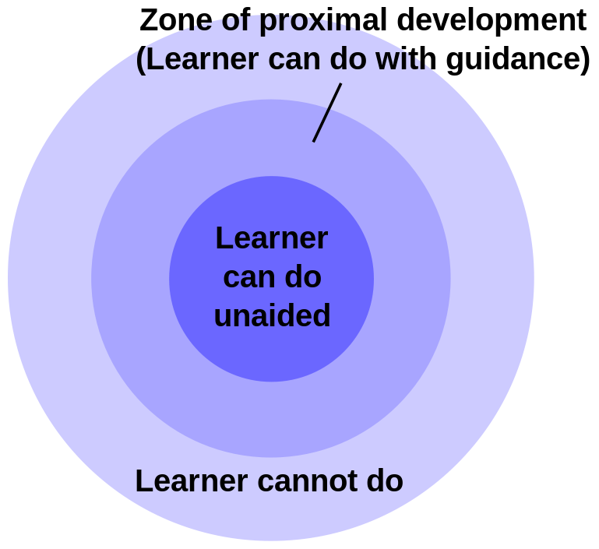
Approaching difficult words and key concepts: Using multiple sources
3. Google Search: “[A concept] is defined as”
“The Zone of Proximal development is defined as the gap between what a student can do alone and what the student can achieve through teacher assistance.”
2. Google Image
4. Google Search: “[A concept] filetype:ppt”
Notes:
Here are three methods for students to use. The first one is typing the name of a concept/term on Google Image, and possibly some graphic explanations will show up. The second is to use the Google search engine to look for different definitions of the same concept. The third one is to search for PowerPoint slides related to a certain concept.

Slide 8

Learning in Class: 3rd tip
Actively engage in class. Feel free to ask if you have any questions.

Slide 9
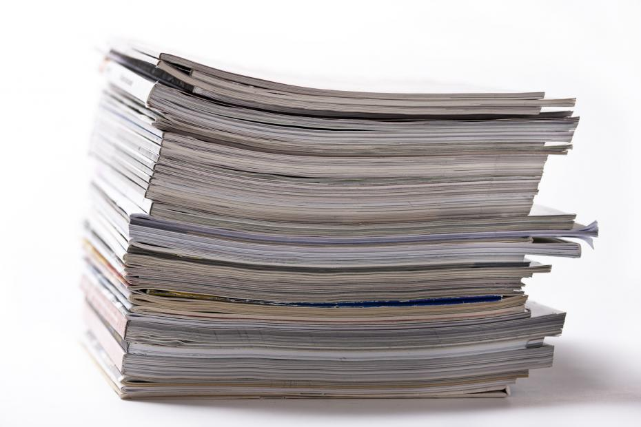
Writing Assignments: 1st tip
Decide on your topic early so you can have more time to read related research

Slide 10
Where to look for related research
Main sources:
1) Journal articles (HKIEd library website)
2) Reference books (Libraries or Google Books)
Tips:
Do not cite Wikipedia entries unless you want to research on Wikipedia. Not all information is correct.
Use Wikipedia only to locate references.
Notes:
Because everyone can edit Wikipedia entries and the authors of those entries may not be experts; therefore, the credibility of the information there is highly questionable. Wikipedia is “banned” in American universities.
There is usually a reference list at the end of every entry. Students can locate, but should not cite, sources on Wikipedia.

Slide 11

Writing Assignments: 2nd tip
Talk about your idea with friends and classmates

Slide 12
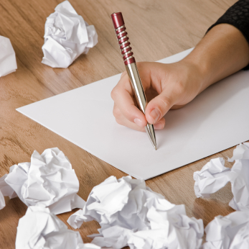
Writing Assignments: 3rd tip
Write early so you have more time to revise your work.

Slide 13
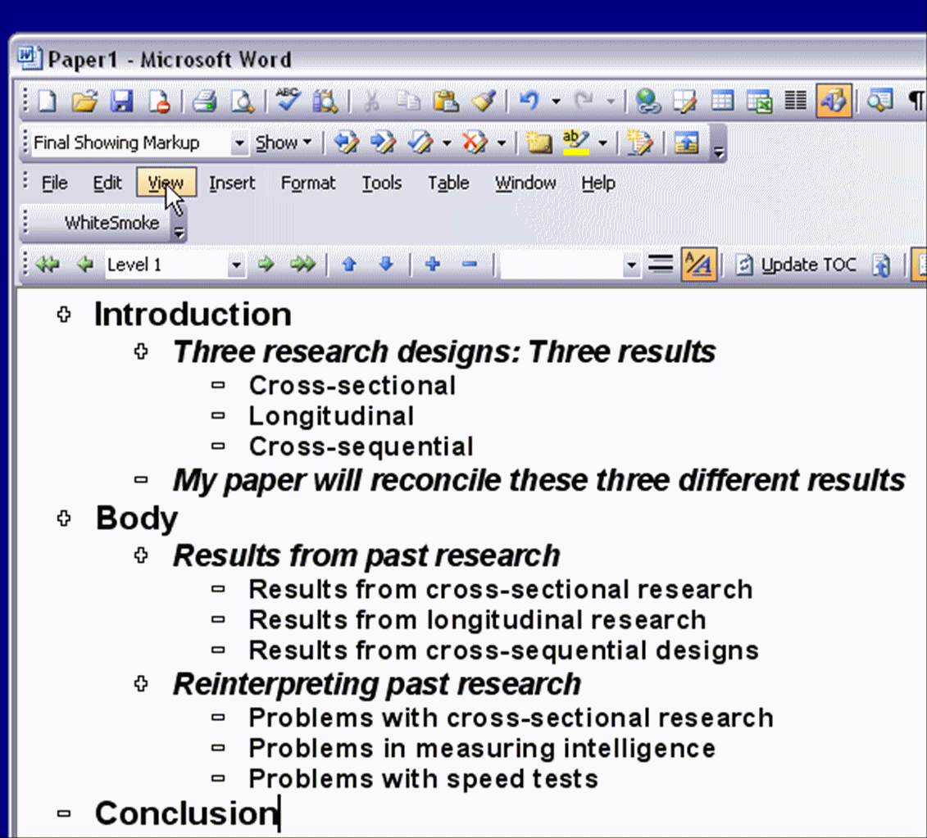
Writing Assignments: 4th tip
Think of a rough outline and constantly revise/refine it.

Slide 14
Writing Assignments: 5th tip
A good piece of writing is cohesive (grammar) and coherent (logic). When you have finished, look at your headings and topic sentences to ensure these features.

Slide 15
Writing Assignments: 6th tip
Look for the right word, and check the usage
1. type a synonym (e.g. say) on Thesaurus.com
2. check an expression on
Google books with “”
Notes:
Search with quotation mark (“ “) let you find the exact phrase

Slide 16
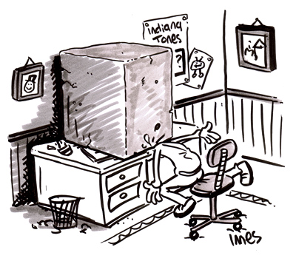
Writing Assignments: 7th tip
Don’t keep on thinking when you have a writer’s block. Read more.

Slide 17
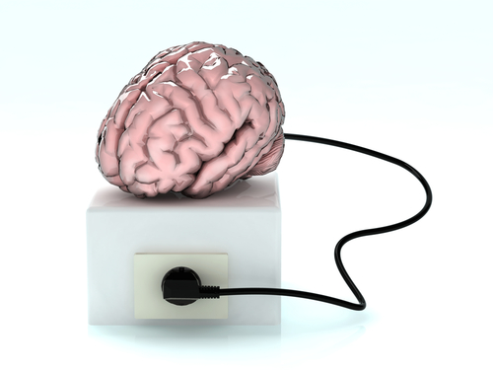
Writing Assignments: 8th tip
Let your brain rest before you revise your essay.

Slide 18
Useful Self-help resources
Yale Graduate School of Arts and Sciences
http://www.yale.edu/graduateschool/writing/tutorials.html
APA Formatting and Style Guide - Purdue Online Writing Lab
https://owl.english.purdue.edu/owl/resource/560/01/
Academic Phrase Bank
http://www.phrasebank.manchester.ac.uk/
Notes:
The Yale one provides comprehensive, yet accessible and concise, guidelines on academic writing. The Purdue (pronunciation: per 雕) one is about formatting in different citation styles.

Slide 19
Academic Writing: Random Tips
Academic writing is more complicated because the target audience are academics, who are conservative & critical.
Academic writing needs to be: Evidence-based, objective, cautious, analytic, & specific

Slide 20
Academic Writing: Random Tips
Academic writing needs to be:
  1. Evidence-based (e.g. bla bla bla (Byun et al., 2010)
  2. Objective (e.g. I think, I guess, it is proved that ……)
  3. Cautious (e.g. It’s got to be like this! It is possible that…)
  4. Analytic (e.g. A says this. B says this. C says that. A and B say this and C says that; the differences come from…)
  5. Specific (e.g. Students are in need of more support Give examples of the support needed)

Slide 21
How to be objective, cautious, analytic and specific: Grammar makes meaning
Examples: I think merely teaching in English would not be useful.
Objective: avoid 1st and 2nd person pronouns
Current researches have corroborated that merely teaching in English would not be useful (in-text citations).
Cautious: use hedging devices
Current research findings indicate that merely teaching in English might not necessarily improve students’ English proficiency (in-text citations).
Notes:
Hedging >>>> http://www.google.com.hk/url?sa=t&rct=j&q=&esrc=s&source=web&cd=3&ved=0CC4QFjAC&url=http%3A%2F%2Fwww.bbk.ac.uk%2Fmybirkbeck%2Fget-ahead-stay-ahead%2Fwriting%2FHedging-in-AcademicWriting.doc&ei=lqLtU6CYCdG48gXBqYCgCw&usg=AFQjCNF_MG4jWMtUYvLsjm6Xt0fEQVhbQw&sig2=ke6TopkYzzv2VgpAvehGJA

Slide 22
How to be objective, cautious, analytic and specific: Grammar makes meaning
Analytic: break down, make connections and give reasons
Current research findings indicate that merely teaching in English might not necessarily improve students’ English proficiency (in-text citations). Findings from bilingual education show that the participants with limited English do not benefit from EMI courses.

Slide 23
How to be objective, cautious, analytic and specific: Grammar makes meaning
Specific: give detailed information
Current research findings, which concerned/concerning mainly EFL students in expanding circle countries, indicate that merely teaching in English might not necessarily improve students’ English proficiency without appropriate scaffolding (in-text citations).

Slide 24
Finally, follow APA!
A sample paper with detailed description of how to do APA
  Sample Paper

Slide 25
Q & A

