Slide 1
STEM education in Taiwan
Ying-Shao Hsu
National Taiwan Normal University

Slide 2
Part 1: Current STEM Education in Taiwan

Slide 3
Education policy
MST
2001 : Announce the “Grade 1-9 Curriculum Guidelines.” 2003 : Announce the “Curriculum Guidelines in the Science and Technology field.”
STEM/STEAM
2014 : Announce the “Curriculum Guidelines of 12-year Compulsory Education-General Guidelines.” 2017 : New Taipei City promoted the “Techshop project” 2018 : Announce the Curriculum Guidelines in science, technology, and mathematic fields.
New STEM/STEAM
2019 : Implement the 12-year compulsory education. Future: Develop and implement STEM curriculum in K-12 schools.
Lin, K. –Y. (2019). Reflection on the current situation of STEM education in Taiwan.
Notes:
Lin, K. –Y. (2019). Reflection on the current situation of STEM education in Taiwan. Journal of Youth Studies January, 21(1),

Slide 4
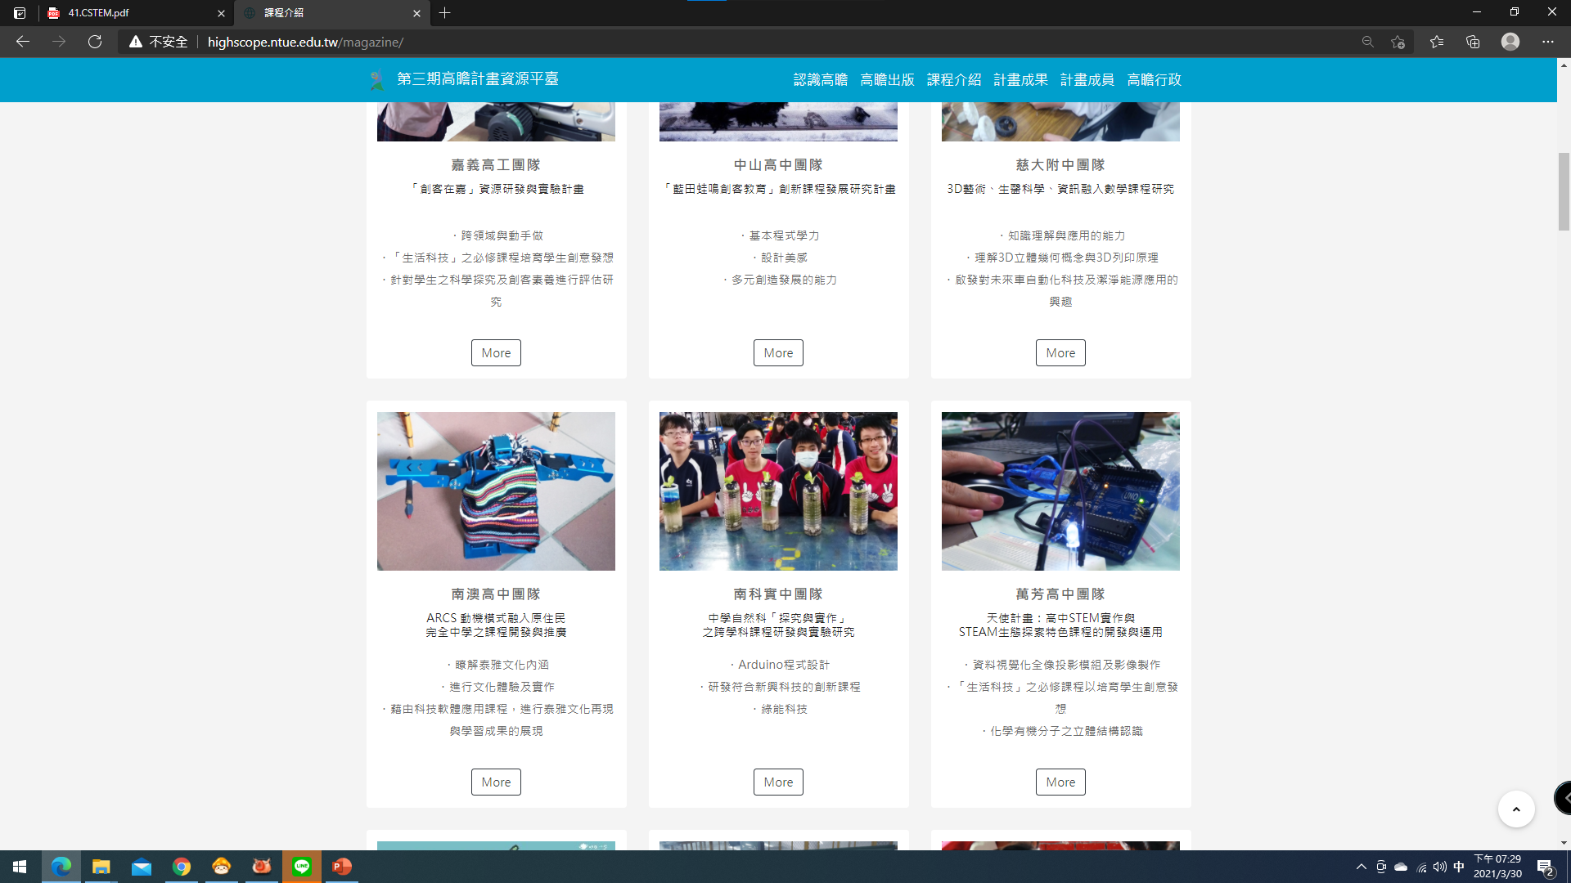
Teaching Practices in STEM Education
The High-Scope project in Taiwan highlights the prominent role of STEM in curriculum development.
Most of the curriculum are not highly-integrated STEM curriculum.
Link: http://highscope.ntue.edu.tw/magazine/

Slide 5
Reflection
The government didn’t have particular educational goals and policies for STEM education.
School teachers need effective professional development programs for implementing STEM teaching practices.
There is a lack of diversified, flexible, and high-quality STEM courses and activities to reach STEM education goals.

Slide 6
Part 2: Students’ STEM Aspiration in Taiwan
(Findings from the Survey across Economies)

Slide 7
Methodology: Survey (online Questionnaire)
  4-point Likert scale from 1 (strongly disagree) to 4 (strongly agree).
  8 parts :
    Demographic characteristics (e.g., Leisure activities)
    parental expectations regarding STEM learning
    STEM opportunities/activities and teaching quality in schools
    Self-efficacy in STEM learning
    values of STEM learning
    participation in out-of-school STEM activities
    perceptions of STEM careers
    STEM career aspirations.
Notes:
The questionnaire was designed with reference to the studies on ‘Challenges and Opportunities with Hong Kong students’ STEM aspirations’ 1 (So & Chiu, 2020), ‘Understanding Young People’s Science Aspirations’ 2 (Archer & Dewitt, 2017), and UNESCO 3 (2017).

Slide 8
Sample in Taiwan: 11-18 years-old students
 | Gender | Respondents | Total
Senior primary | male | 38 | 71
 | female | 33
Senior second | male | 86 | 111
 | female | 25

Slide 11
Self-efficacy in STEM
Notes:
F: female, M: male

Slide 12
Self-efficacy in STEM

Slide 13
Self-efficacy in STEM

Slide 14
Self-efficacy in STEM

Slide 15
Multiple Regression
The means of items in each variable were used for multiple regression analysis.
Apply the method of “STEPWISE”
Independent variables |  | Dependent variables
Leisure activities access STEM information parental expectations school STEM opportunities school STEM quality self-efficacy in Math | self-efficacy in Math self-efficacy in Science self-efficacy in IT self-efficacy in Engineering National identity STEM learning purposes views towards STEM professionals | STEM career aspirations

Slide 16
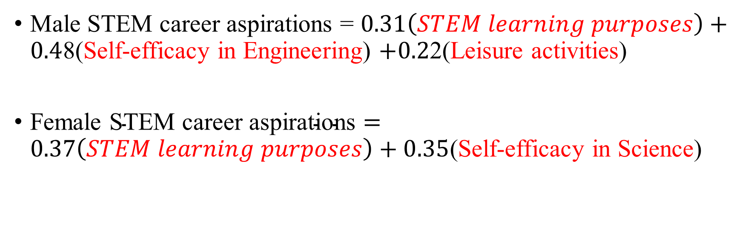
Multiple Regression for Male and Female Students
Male STEM career aspirations = $0.31\left(STEM learning purposes\right)+0.4$8(Self-efficacy in Engineering) $+0.2$2(Leisure activities)
Female $\text{STEM} \text{career} \text{aspirations}=0.37\left(STEM learning purposes\right)+0.35$(Self-efficacy in Science)

Slide 17
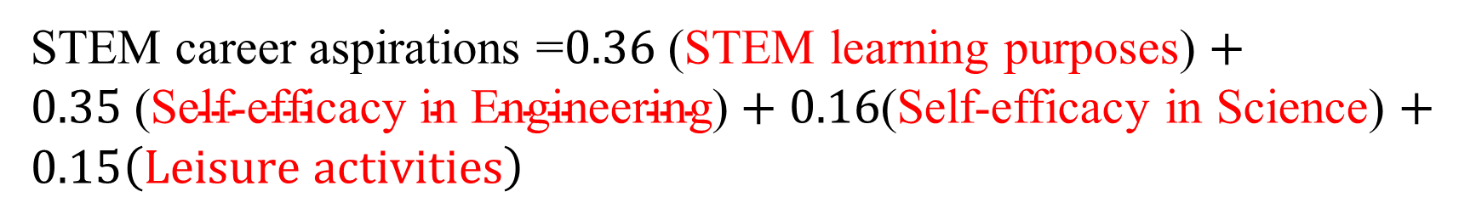
Multiple regression
4 factors affecting all students’ STEM career aspirations.
STEM career aspirations =$0.36$(STEM learning purposes) $+$
$0.35 \text{(}\text{Self}\text{−}\text{efficacy} \text{in} \text{Engineering}\text{)}+0.16$(Self-efficacy in Science) $+$ $0.15\left(Leisure activities\right)$

Slide 18
Part 3: Teachers’ Beliefs about STEM Education

Slide 19
Questionnaire: STEM Teachers’ Teaching Beliefs Investigation Questionnaire, STEM-TTBIQ
  5-point Liker scale.
  Five parts in the STEM-TTBIQ:
  (1) understanding of STEM teaching (strategy A, B, C)
  (2) teachers’ background (e.g., teaching subject, seniority)
  (3) the experience of STEM teaching (with or without)
  (4)STEM educational goals (e.g., 21st Century Skills )
  (5) self-efficacy of STEM teaching
  The Cronbach’s α > 0.8 (all items in the STEM-TTBIQ)
  Exploratory factor analysis (EFA) indicated that the factors explained 62% of the variance of teachers’ self efficacy.

Slide 20
Sampling
Stratified Random Sampling based on locations (all science, technology, and mathematics secondary teachers in a randomly-selected school)
The valid sample size = 653 (705 - 52 invalid)
STEM teaching Experience | Respondents | Valid samples
Yes | 205 | 653
No | 448

Slide 21
Preliminary Findings
Strategy A: Teachers instruct individual subject separately but prepare STEM lessons together
Strategy B: The tech teacher is the main instructor and other subject teachers help guide students’ STEM learning during enacting STEM lessons
Strategy C: All teachers prepare integrated STEM lessons based on the project-based learning approach and enact as team-teaching
STEM teachers’ understanding of STEM education
Most teachers expect to use strategy C in their STEM courses (χ² (3) = 319.319, p < .01 ).
Most teachers adopt strategy A in schools (χ² (3) = 300.513, p < .01 ).

Slide 22
Preliminary findings
STEM teachers’ perceptions of STEM education goals
Independent variable:
STEM teaching experience
No vs. Yes
Teaching strategy
A vs. B vs. C
Dependent variables:
Goals of STEM education
21st Century Skills (8 items)
STEM Literacy (4 items)
Transformative Competency in Problem Solving (5 items)

Slide 23
Preliminary findings
Compare different STEM teaching experience teachers’ recognitions in STEM education goals (total scores for each dimension: 40, 20, 25 separately)
t = 2.17, p = 0.03
t = 1.76, p = 0.08
t = 2.62, p = 0.01
Notes:
No: no experience of STEM teaching
Yes: have STEM teaching experience

Slide 24
Preliminary findings
Compare teachers’ viewpoints about single subject and interdisciplinary teaching using three teaching strategies (A vs. B vs. C) to achieve STEM educational goals
Single subject to achieve Transformative Competency
No significance
(F = 2.172, p..05)
Interdisciplinary subject to achieve STEM literacy
Strategy B , C > strategy A
(F = 7.655, = <.05)
Single subject to achieve STEM literacy
Strategy A > strategy C
(F = 3.251, p< .05)
Interdisciplinary subject to achieve Transformative Competency
Strategy C > strategy A
(F = 7.655, p< .001)
Single subject to achieve 21st century skills
Strategy A > strategy C
(F = 4.669, p < .05)
Interdisciplinary subject to
achieve 21st century skills
Strategy B , C > strategy A
(F = 7.605, p <.05)

Slide 25
Preliminary findings
Compare the teachers’ self-efficacy across those who were with and without STEM teaching experiences:
  A) STEM curriculum design
  B) STEM curriculum implement
  C) STEM curriculum outreach
t = 7.97, p < 0.001
t = 8.29, p < 0.001
t = 8.52, p < 0.001

Slide 26
Summary
Strategy C was teachers’ expected STEM teaching strategy no matter with or without STEM teaching experiences, but they usually adopt strategy A in schools.
Experienced STEM teachers had higher recognition in achieving goals of 21st century skills and transformative competency in problem solving than those without STEM teaching experiences.
Teachers who picked STEM teaching strategy C thought that 21st century skills, STEM literacy, and problem-solving skills could be achieved through interdisciplinary teaching as opposed to those who choose strategy A.
Experienced STEM teachers demonstrated higher self-efficacy in curriculum design, implement, and outreach.
Notes:
The findings could be used to respond to the reflection on STEM education in Taiwan.

Slide 27
Thank you for your attention

