Slide 1

Promoting Students' STEM Aspiration – Hong Kong
Prof. SO Wing Mui Winnie & Dr. CHEN Yu
Education University of Hong Kong
Web Conference on Promoting Students' STEM Aspiration
14th April, 2021 (Wed), 13:00-16:30 Hong Kong Time
Notes:
I’m very thankful for having this opportunity to join the Web Conference on Promoting Students' STEM Aspiration, and to share the findings of Hong Kong students.

Slide 2
Outline
1. Support for STEM education and careers
2. Students
Percieve STEM Professionals?
3. Suggestions
Willing to learn STEM?
Aspire STEM career?
Policy
& Budget
STEM learning & careers
STEM education policy
School
experiences
Outside
school
Notes:
The presentation will start from talking about policy, school and home support for STEM education, then the levels of Hong Kong students’ willingness to be engaged in STEM learning or careers, their perceptions of STEM professionals, and finally some suggestions.

Slide 3
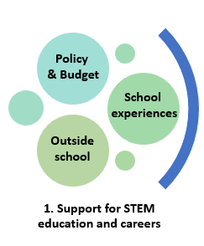
What efforts have been made by the government on promoting STEM education and careers?
Do school provide enough STEM learning opportunities for students?
Are students provided with multiple resources for STEM learning after school?
Notes:
I will firstly talk about the efforts made by the government based on analyzing the policy address and the budget from 2015 to 2020, and then some results related to school STEM learning and STEM activities outside school.

Slide 4
Government emphasis on STEM education and careers
STEM education
Quality Education Fund
The STEM education center
IT skills & information literacy
Innovation Lab in secondary schools
Renew school curricula
Subsidy to primary and secondary schools
Out-of-classroom STEM experiences
Life-wide Learning Grant
Ongoing renew school curricula
Pursue STEM-related subjects
2015
2019
2020
2016
2017
2018
The Innovation and Technology Fund
I & T Start-ups
The Corporate Venture Fund (CVF)
The Innovation and Technology Venture Fund
The Cyberport Macro Fund
Global STEM Professorship Scheme
The Research Talent Hub
STEM Internship Scheme
The Greater Bay Area Youth Employment Scheme
The Re-industrialization and Technology Training Programme
Co-operation with mainland
I&T enterprises & employment
Notes:
This is a summary of the key policies for STEM education and I&T industries have been proposed in the last few years. From 2015, the government has been stepping up efforts to promote STEM education in primary and secondary schools through ongoing curriculum renewal, offering subsidy, promoting out-of-classroom STEM experiences, or more recently in 2019, the establishment of the science lab scheme, for developing I&T literacy among students. On the other hand, efforts have been made on promoting I&T enterprises through supporting start-ups, setting up IT venture fund. In 2020, several new schemes were launched, such as the global STEM professional scheme, indicating the strong hope of the government to make Hong Kong a more competitive I&T center through attracting more I & T talents to come to Hong Kong.

Slide 5
STEM-related experiences at school
Enough STEM exposure at school
Actively engaged in STEM learning
 | Agree (%)
My teacher tells me how to do better when I make mistake. | 92.5
I learn interesting things from STEM. | 90.4
I look forward to STEM learning opportunities. | 89.9
My teachers have adequate STEM knowledge. | 89.6
My teacher has clear answer to my question. | 89.2
My teacher lets me show what I have learned. | 88.2
My teacher does various activities to help us learn STEM. | 84.2
My teacher is good at explaining the STEM content. | 83.5
My teacher listens to what I say about STEM. | 81.6
 | Agree (%)
I don’t have enough opportunities to engage in STEM learning. (N) | 33.6
I think my school does not attach great importance to STEM. (N) | 22.5
outside of class time. | 78.0
In IT-related lessons | 83.4
In science-related lessons | 82.4
in Math lessons. | 73.8
in other lessons. (e.g. Arts, Music, Sports and language studies) | 68.3
in Engineering-related lessons. | 27.8
Notes:
With the support of the government, most schools in Hong Kong implement STEM education. The majority integrate STEM elements in current school curriculum, mainly science, mathematics, or technology curriculum. Similar findings can be found in our results. Most students reported that they had enough STEM opportunities in science, technology, mathematics lessons, and felt engaged in STEM learning. However, it was noted that not many students reported that they had STEM opportunities in engineering lessons, might due to that there was no specific engineering courses in most HK schools.

Slide 6
STEM learning outside school
Less than 35% students
read STEM books or magazines during their leisure time every week
Less than 50% students
had 10 or more STEM books at home
Notes:
The support from home or parents is also important. However, our results indicated that students might lack support for STEM learning at home or from their parents. Less than 50% of the students had 10 or more books, and less than 35% read STEM books or magazines weekly.

Slide 7
Use of e-resources for STEM learning
90% used mobiles and/or computers every day
Seldom visited STEM-related websites
Notes:
Students used digital devices every day, but they seldom visited STEM-related websites to access STEM information. One possible reason was that students were less interested in knowing STEM information. It was also possible that students need some guidance for sourcing STEM information via useful links.

Slide 8
Visits to Science museums/exhibitions
Mostly went to science museums or exhibitions once or twice per year
Notes:
HK students generally visited science museum or exhibitions once or twice per year, which was not that frequent.
.

Slide 9
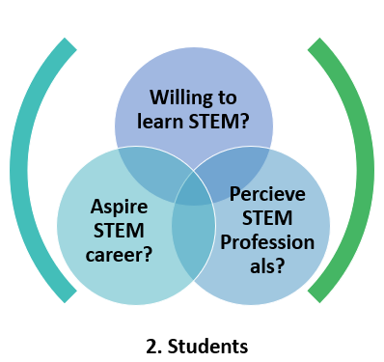
Are students willing to choose STEM subjects?
Will students choose STEM careers in the future? What are the underlying factors?
How do students perceive STEM professionals and their work? How it impacts STEM self-efficacy, and career aspirations?
Notes:
Next, I will share some findings from the students’ side.

Slide 10
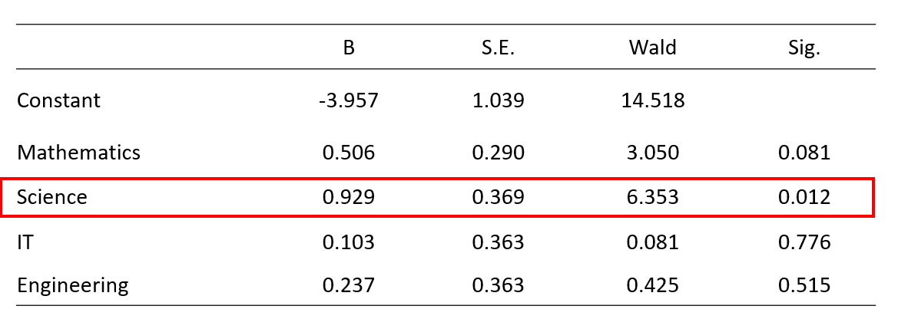
Willingness to STEM Learning
56% were willing to choose STEM-related subjects in their future study.
Science self-efficacy as the key predictor
Notes:
Out results revealed that around 50% of the students were willing to choose STEM subjects in their future study. Science self-efficacy was the significant predictor of STEM subject choices. That is, students with stronger self-confidence in learning science were more likely to show persistence in STEM learning.

Slide 11
Purposes for STEM learning
Meet the global trends
To meet the trend of the high-tech world.
Contribution to society
To become a future talent of society.
To improve on the living condition in the modern world.
To contribute to global sustainable development.
To contribute to the economy of society.
To meet the innovative technology needs of society.
Meet parental expectation
To meet my parents’ expectation on subject selection.
To meet my parents’ expectation on my future career.
To get the approval of relatives and friends.
To meet personal curiosity and interest.
Achieve personal interests
To prepare for choosing my favorite subject in the future.
To equip myself to cope with future work.
70.7% 76.3% 79.8%
Above
70%
73.0% 71.1% 77.6%
51.8% 52.0% 45.2%
Around
50%
81.6% 75.5% 81.1%
Roughly 80%
Notes:
Students mostly chose STEM learning because of their personal interests. For above 70% students, their purposes of STEM learning were to make contribution to local society and the world. Comparatively a smaller percentage of students agreed that they chose STEM learning because they wanted to appeal to parental expectations. This indicated that parents might be less influential in motivating students’ STEM learning. While, how students perceived the internal interests and external values of STEM learning were more likely to influence their choices of whether or not to pursue STEM subjects at school.

Slide 12
Major industries to work in
Notes:
For STEM career aspirations, the most chosen industries were medial services, the second was Innovation and Technology. Looking at the other side of this chart, however, almost few students chose those fields, such as: trading and logistics, environmental services, testing and certification. Students might lack adequate knowledge of these three industries. That’s why they did not choose them.

Slide 13
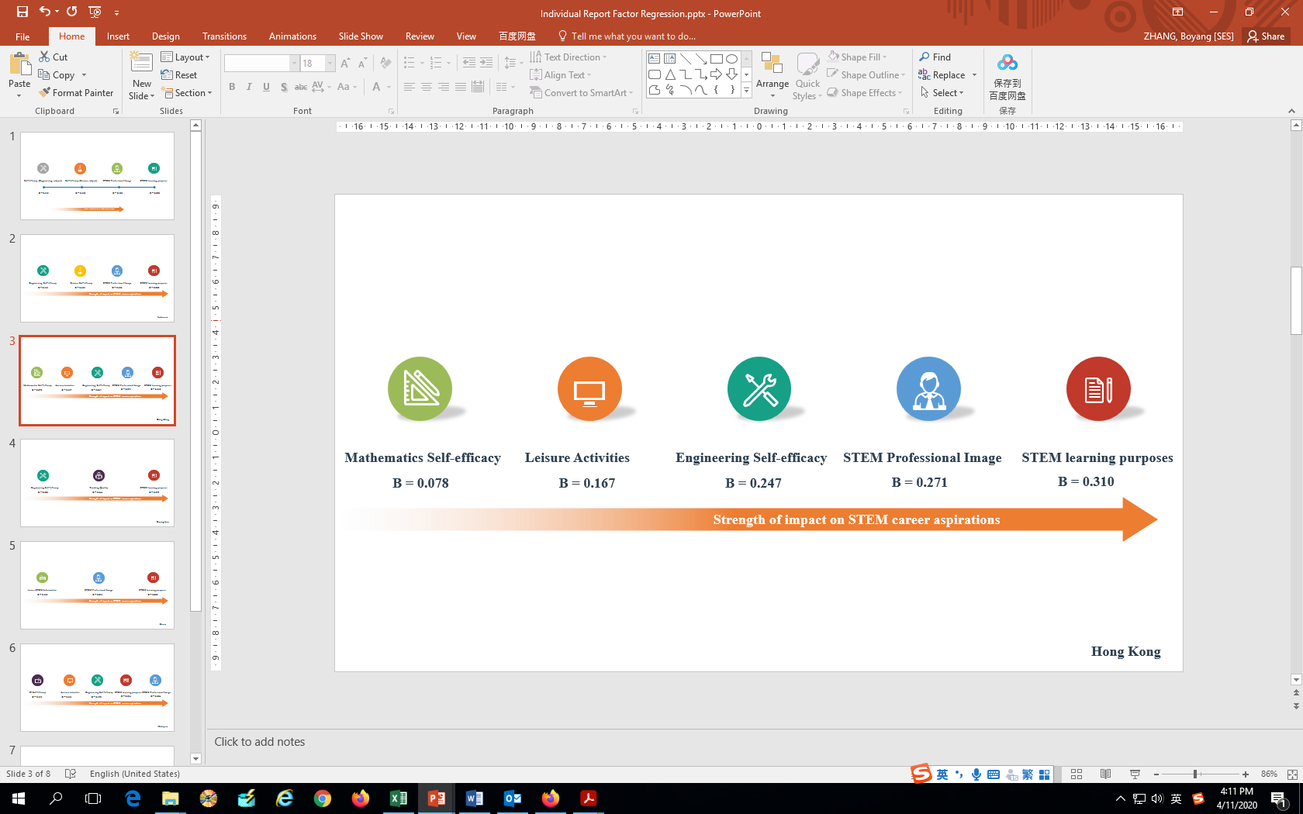
Predictors of students’ STEM career aspirations
Using a multiple regression analysis, five significant predictors were found
Regression Test
Notes:
In order to know the possible predictors of HK students’ STEM career aspiration, we used a multiple regression analysis. We identified the five significant predictors: STEM learning purposes, perceptions of STEM professionals, engineering self-efficacy, mathematics self-efficacy etc. It means that, when encouraging students to choose STEM careers, helping students to value their STEM learning, to develop favorable images of STEM professionals, or to build strong confidence in personal abilities of learning STEM can be useful to some extent.
In view of the important role of perceptions of STEM professionals in predicting STEM career aspirations, we did a follow-up data analysis, with a specific focus on exploring the relationships between these two.

Slide 14
Patterns of HK students’ perceptions of STEM professionals
Using a confirmatory factor analysis (CFA), seven factors were extracted.
HK students might be less positive, particularly the emotional aspects of STEM professionals, as compared to the other regions.
Tasks, and competencies
Success / Emotional or social aspects
Notes:
Firstly, we used confirmatory factor analysis (CFA) and found 7 dimensions underlying perceptions of STEM professionals. Let’s have a look at the table. Compared to the other regions, HK students had the lowest scores in job satisfaction, contribution, fame, but the highest scores in social isolation or risks. This implied that HK students might be less positive in perceiving STEM professionals, particularly their emotional or social aspects, than students from other regions. Hong Kong students were more likely to consider STEM professionals as boring, working alone, or their work might be full of risks or dangers.

Slide 15
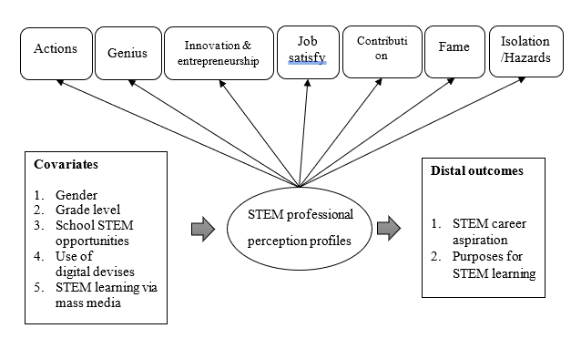
What are the latent profiles of STEM professional perceptions?
How these perceptions of STEM Professionals (a) affected distal outcomes or (b) is affected by other covariates?
The hypothesized model using a latent profile analysis (LPA)
Notes:
Secondly, we examined the relationships of perceptions of STEM professionals with other variables using a latent profile analysis. We expected to know: If there were sub-groups of students who shared the similar patterns in perceiving STEM professionals? whether perceptions of STEM professionals affected STEM career aspirations or purposes/goals of STEM learning? whether there were differences in perceptions of STEM professionals by these covariates? This is our hypothesized model.

Slide 16
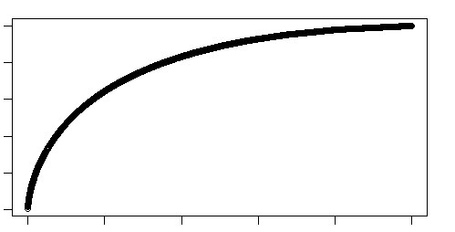
Perceptions and Aspirations
- Based on the motivational theory of role modelling
(Kenneth Jones & Hite, 2020; Morgenroth & Ryan, 2015)
→ Non-linear relationships
STEM professionals attributes
What are their tasks (work activities)?
STEM professional as the behavioral model, the possible, or inspirations
Goal Embodiment
Outcomes
Goals of STEM learning
How they do their tasks (competences)?
What qualities do they have (success, work conditions, sociability)?
Desirability
Aspirations to STEM careers
Attainability
Positive
Positive
But, what if too positive, too successful? → Negative outcomes
Notes:
We used the motivational theory of role modelling as the theoretical base of our hypothesized model. According to the theory, generally there would be positive relations between how students perceived the attributes of STEM professionals and the extent to which they aspired STEM learning or careers. Students with more positive perceptions were more likely to choose STEM learning or careers, whereas for students who perceived STEM professionals as not attractive, not competent, or unsuccessful, they might not want to become STEM professionals. In most situations, the relationships between these two would be like this, the positive linear relationships. But, what if students held too positive perceptions, perceiving STEM professional as too successful? There might be some negative outcomes, rather than, positive outcomes. Students might think STEM professionals as out of reach. It was hard or almost impossible for them to reach those goals or success of STME professionals. When students viewed STEM professionals as low attainable, they were not willing to have STEM careers in the future either. So, it was not the more positive the better. Therefore, we developed the mode mentioned above and used the latent profile analysis to examine whether there were significant differences in STEM career aspirations between students with different perceptions about STEM professionals.

Slide 17
Four-profile model of STEM professional perceptions
A latent profile analysis → four profiles. HK students → profile 1 and profile 2
Profile 1
very negative
Profile 2
Moderately negative
Profile 3
Moderately positive
Profile 4
Very positive
Notes:
Here comes to the results. A four-profile model was chosen as the best model to fit our data based on model fit tests. The four profiles according to the factor scores of the seven perception dimensions, were named: very negative, moderately negative, moderately positive, very positive. HK students were more likely to be classified in profile 1 and profile 2, as compared to other regions’ students, indicating that HK students were relatively more negative in viewing STEM professionals.

Slide 18
Perception profiles in relation to STEM career aspiration
Significant lower STEM career aspirations of students in profile 1 and profile 2
No significant difference between profile 3 and profile 4
Profile 1
very negative
Profile 2
Moderately negative
Profile 3
Moderately positive
Profile 4
Very positive
HK students → profile 1 and profile 2
Notes:
This red line shows the likelihood of choosing STEM careers among the students. It was found students in profile 1 and profile 2 who held negative perceptions reported significantly lower STEM career aspirations. One explanation for this was that students’ negative views of STEM professionals decreased their desirability of becoming STEM professionals. When students viewed STEM professionals as less desirable, they showed low motivations to work in STEM fields in the future. This suggested that for these students, typically such as HK students, it is needed to alter their existing negative or stereotypical views regarding STEM professionals so as to better promote their STEM career aspirations.

Slide 19
Perception profiles in relation to objectives of STEM learning
Profile 3 and Profile 4 showed stronger objectives of STEM learning
Notes:
The figure shows the results of perceptions in relation to purposes of STEM learning. students had stronger goals/purposes of STEM learning when they developed more positive perceptions of STEM professionals. In other words, positive perceptions of STEM professionals might lead to goal reinforcement.

Slide 20
Possible ways to develop perceptions of STEM professionals
 |  | Reference Profile 1 Very negative | Reference Profile 2 Moderately negative | Reference Profile 3 Moderately positive
Profile 3 on | Gender | -0.455 | -0.03
 | Primary | -2.026*** | 0.155
 | Junior Secondary | -1.834*** | -0.132
 | School STEM opportunities | 0.729** | 0.288*
 | Mobile use | 0.058 | -0.042
 | Accesses to Mass media | 0.104 | 0.133*
Profile 4 on | Gender | 0.002 | 0.457*** | 0.487
 | Primary | -1.954*** | 0.072 | -0.083
 | Junior Secondary | -1.520** | 0.314 | 0.446
 | School STEM opportunities | 1.263*** | 0.534*** | 0.247
 | Mobile use | --0.162 | -0.219*** | -0.177
 | Accesses to Mass media | 0.285* | 0.181** | 0.068
Profile 1 or Profile 2
Girls
Primary or junior secondary students
Profile 3 or Profile 4
Boys
Senior secondary students
Students spent more time on mobile or computer use
Students having more school STEM opportunities
Students more accessed STEM information via mass media
Negative
Positive
Profile differences in perceptions by covariates
Notes:
Overall, holding positive perceptions regarding STEM professionals to large extent were beneficial for students to pursue STEM learning or careers. This leads to another question: what are the possible ways to develop those perceptions among students? Based on the analysis of profile differences by these covariates, one possible way was to increase student exposure to STEM resources, as students had more STEM opportunities at school or accessed STEM information more often during their leisure time reported more positive perceptions. In addition, specific support to girls or younger learners might be needed as girls, primary or junior secondary students tended to view STEM professionals more negatively.

Slide 21
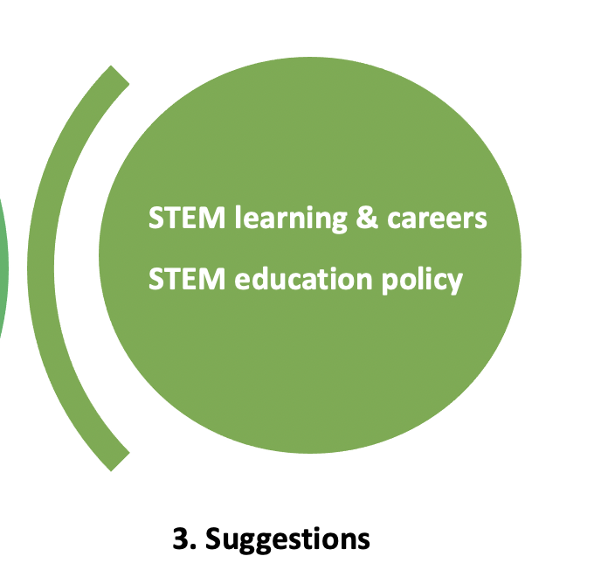
What are the suggestions to motivate students in STEM learning or careers?
  Develop STEM competencies;
  More STEM learning opportunities, particularly engineering-related;
  Increase desirability of STEM professionals
  Alter social stereotypes of I&T jobs
Notes:
According to our findings, here are some suggestions. Firstly, it is important to develop STEM competencies among students, as shown in our results, self-efficacy was important predictor of students’ decisions to STEM learning but also future STEM careers. Secondly, increasing students’ STEM experiences inside or outside school can also be useful. Schools might consider providing more engineering experiences for students. Thirdly, for HK students, it is particularly important to increase their desirability of professionals in diverse STEM fields. Efforts can be made to develop students’ understanding of professionals in some specific fields, as we mentioned before, the fields of environmental services, logistics, or testing; in addition, efforts can be made to change students’ stereotypes through altering social stereotypes regarding I&T. This needs the government to continue to make efforts on promoting I&T enterprises.

Slide 22
Thank you very much!
wiso@eduhk.hk
chenyu@eduhk.hk
Notes:
That’s all for our presentation. If you are interested in any parts, please feel free to contact us at these emails. Thank you very much.

